Slide 1




Universitat Oberta
de Catalunya
uoc.edu
IMPACT OF 5-FU TREATMENT ON TUMOR CELL PLASTICITY IN COLORECTAL CANCER
Tutor/a de TFM: Laia Bassaganyas Bars
Professor/a responsable de l’assignatura: David Merino Arranz
Autor/a: Miquel Gratacós i Aurich

Slide 2
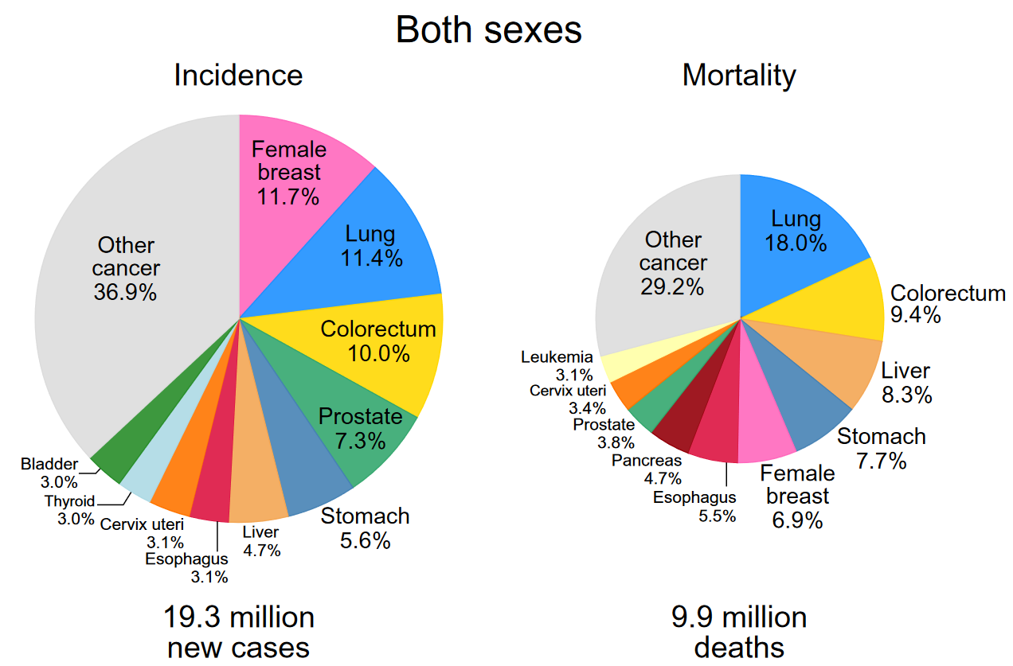
Universitat Oberta
de Catalunya
uoc.edu
INTRODUCTION
More than 1.9 million new colorectal cancer cases.
935 000 deaths were estimated (2020)
Third in incidence, second in mortality
Can be considered a marker of socioeconomic development
Primary prevention as key strategy to reduce the growing burden
Fig 1. Distribution of incidence and mortality rates from the Top 10 Most Common Cancers in 2020 in Both Sexes. Image extracted from GLOBOCAN 2020.

Slide 3
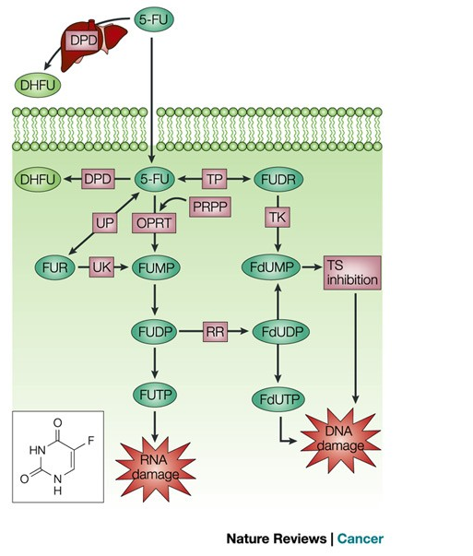
Universitat Oberta
de Catalunya
uoc.edu
TREATMENTS
Surgery is the primary curative treatment.
5-Fluorouracil (5-FU) Chemotherapy as main systemic treatment since the 1990s.
Intravenous or oral administration
Blockage DNA and RNA synthesis
One of the most effective treatments
Could be administrated with other drugs
Some patients could develop resistance to 5-FU
Fig 2. 5-Fluorouracil metabolism. Image extracted from: 5-Fluorouracil: mechanisms of action and clinical strategies. https://doi.org/10.1038/nrc1074

Slide 4
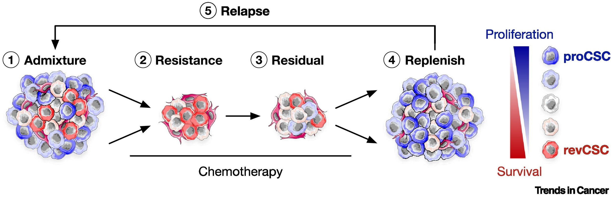
Universitat Oberta
de Catalunya
uoc.edu
CELLULAR PLASTICY
Cell plasticity is key in the tolerance to the treatment for Colorectal cancer (CRC).
Cancer stem cells (CSCs) crucial for tumor progress, and all the mechanism that promote the relapse of the cancer.
Fig 3 Colorectal cancer (CRC) chemorefractory plasticity cycle model. Image extracted from: Plastic persisters: revival stem cells in colorectal cancer. https://doi.org/10.1016/j.trecan.2023.11.003

Slide 5
Universitat Oberta
de Catalunya
uoc.edu
scRNA-seq TECHNOLOGY
Advances in single-cell have provided powerful new tools for: (1) identifying cell types and (2) whole-transcriptome profiling of individual cells, (3) Inference of complex gene-gene regulatory networks, (4) tracing developmental lineages.
Mapping of scRNAseq clusters based on the differentially expressed genes (DEGs)
Cell-Cell Communicative analysis (CCC)
Ligand-Receptor (LR) interactions
Study of Tumor microenvironment (TME)

Slide 6
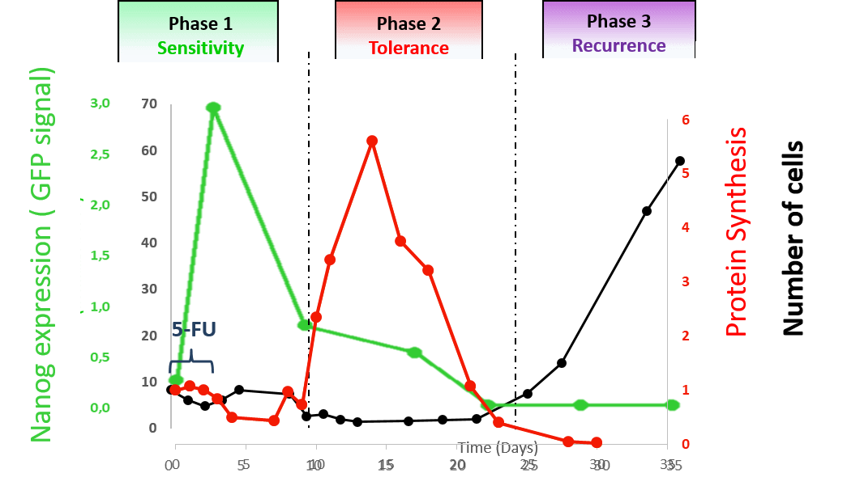
Universitat Oberta
de Catalunya
uoc.edu
CONTEXT OF THE WORK
Collaborative project between Institute de Génomique fonctionell (IGF) of Montpellier and the Lyon Cancer Research Center (CRLCL).
Preliminary in-vitro data have shown that 5-FU based chemotherapy, induces increased translational activity during the “tolerance phase”, followed by a resumption of cell division.
scRNA-seq was conducted at various time points using the in vitro experimental model, in cultured CRC cells.
Figure 4. Experimental model summarizing 5-FU induced tolerance. By analyzing cell viability, three phases have been identified: (1) the sensitive phase, characterized by slowing of cell proliferation causing the death of cells sensitive to 5-FU. An increased expression of pluripotent-related genes is also observed; (2) the tolerance phase during which cells no longer proliferate but exhibits strong transcriptional activity; and finally (3) the recurrence phase, characterized by the resumption of proliferation and mimicking tumor recurrence.

Slide 7
Universitat Oberta
de Catalunya
uoc.edu
OBJECTIVES
Characterize relevant cancer cell subpopulations appearing in response to 5-FU. *
Establish CCC networks between cell subpopulations. *
Demonstrate that translational control is one of the molecular mechanisms responsible for cellular reprogramming in response to 5-FU.
Determine the exact role of these subpopulations in treatment tolerance and tumor recurrence.
* Specifically, this study will focus on achieving objectives 1 and 2.

Slide 8

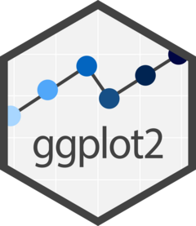
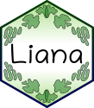


Universitat Oberta
de Catalunya
uoc.edu
METHODS
By Seurat package (v5.0), 2 analysis were performed:
By Time points analysis
Integrative analysis
Quality-Control, normalization and scale of the data was assessed
Two different Clusters were defined:
Seurat’s Algorithm Cluster identification
CancerSEA : a Cancer single-cell state atlas
Cell-Cell Comunication (CCC) between the identified clusters
Ligand-Receptor (LR) Interaction analyzing for the understanding of CCC
Fig 5. R-studio packages used during the development of the results. Renv, ggplot2, Liana, Seurat v5.0, among others.

Slide 9
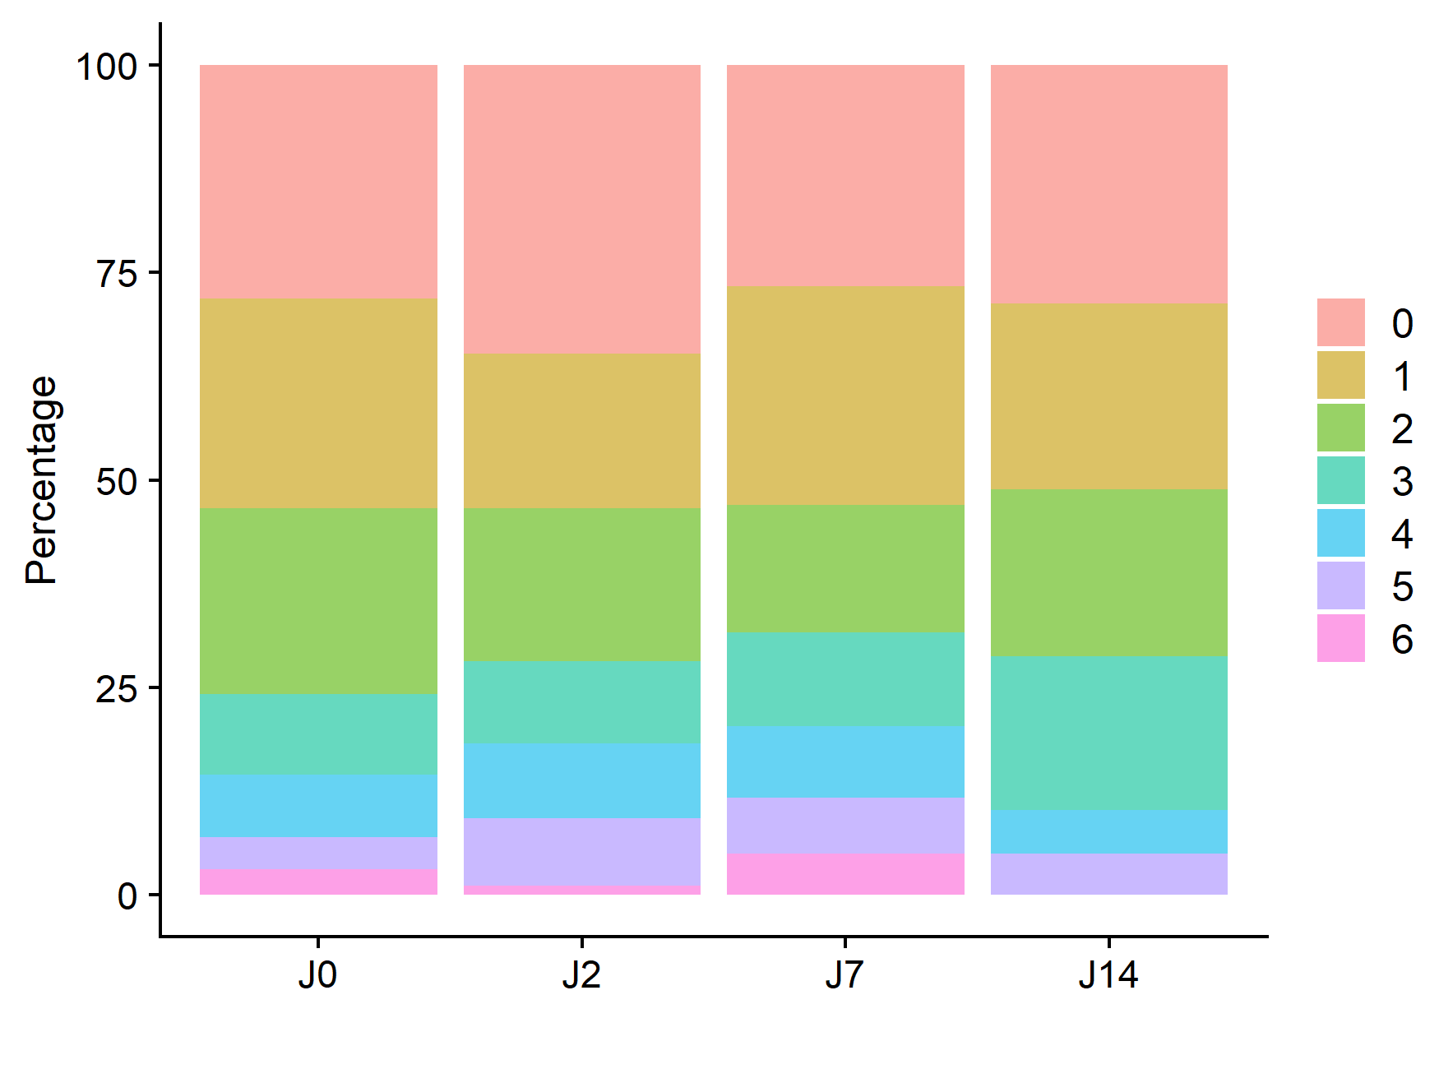
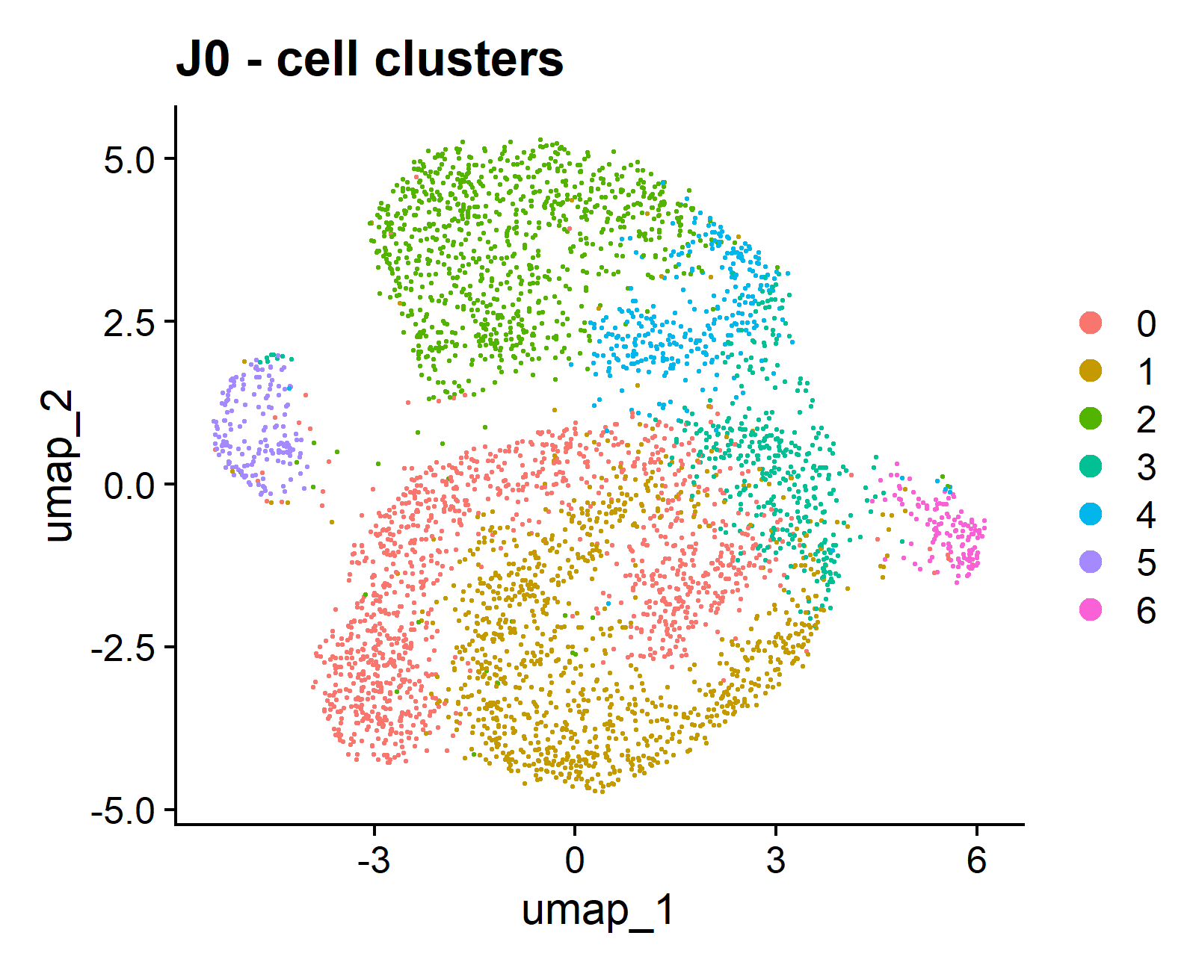
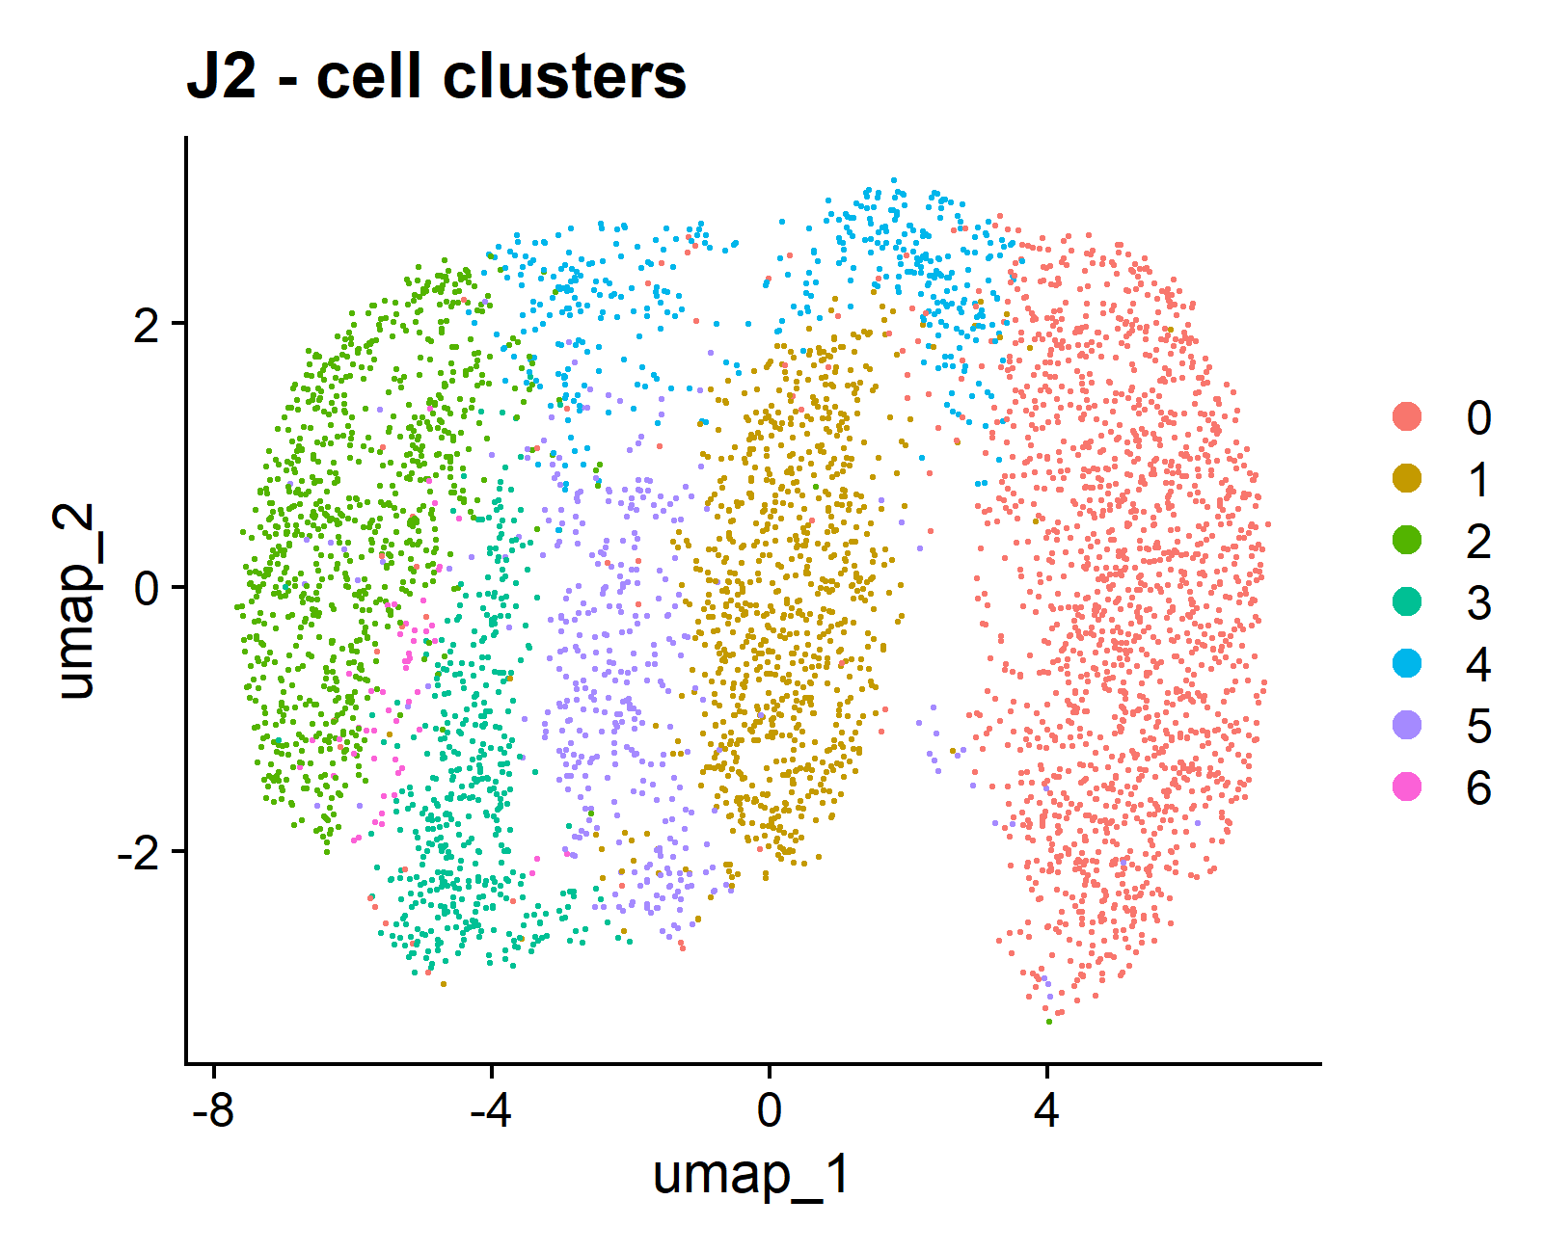
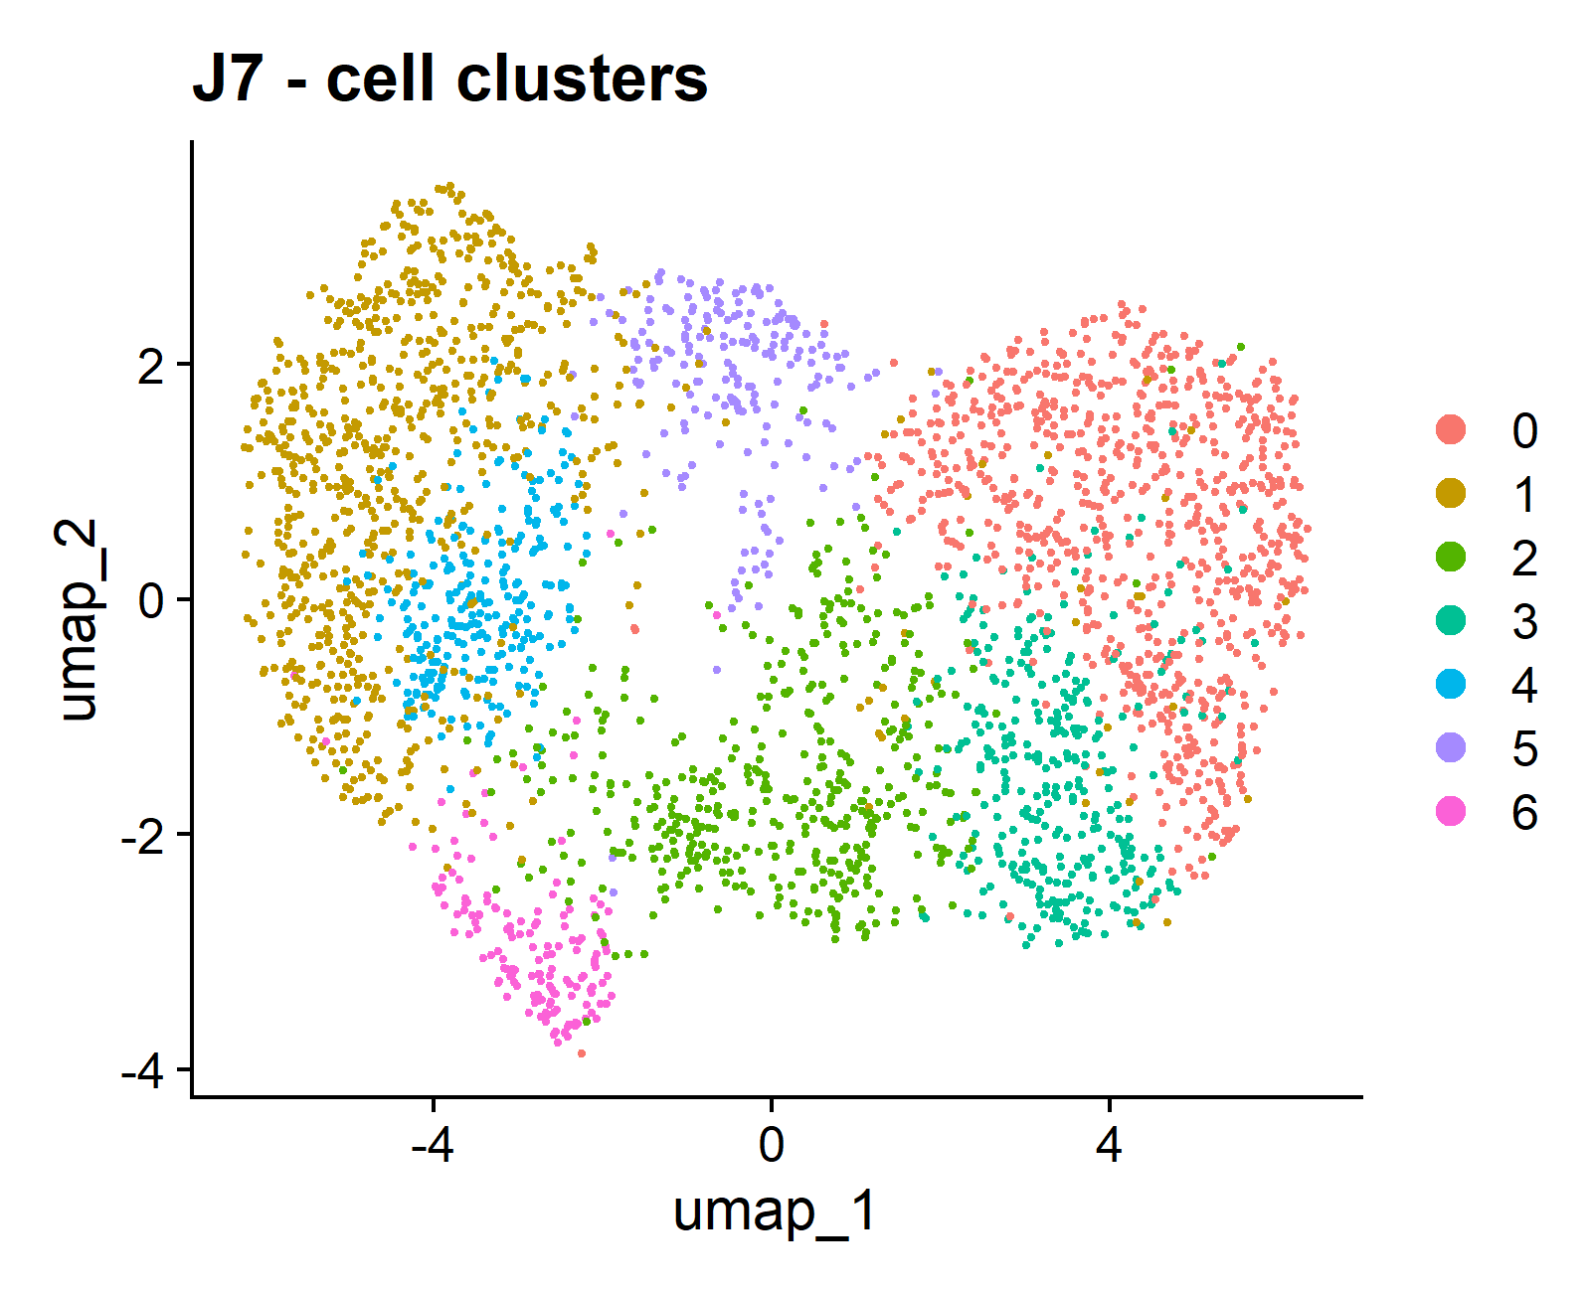
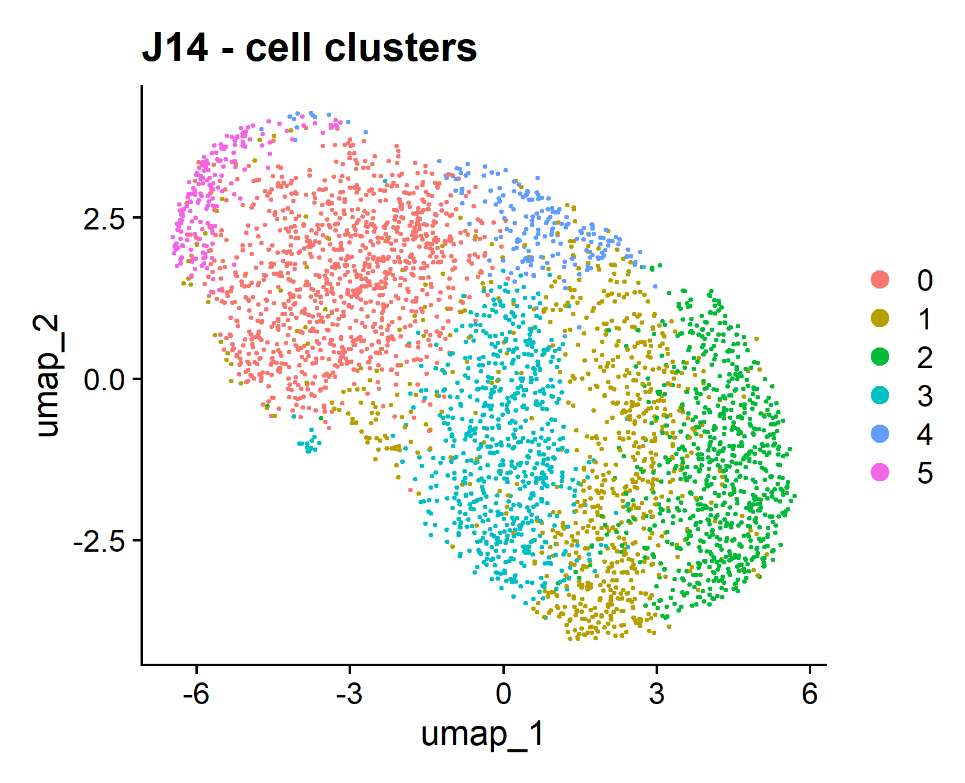
Universitat Oberta
de Catalunya
uoc.edu
RESULTS
B)
A)
By Time points
Seurat Clusters
C)
D)

Slide 10
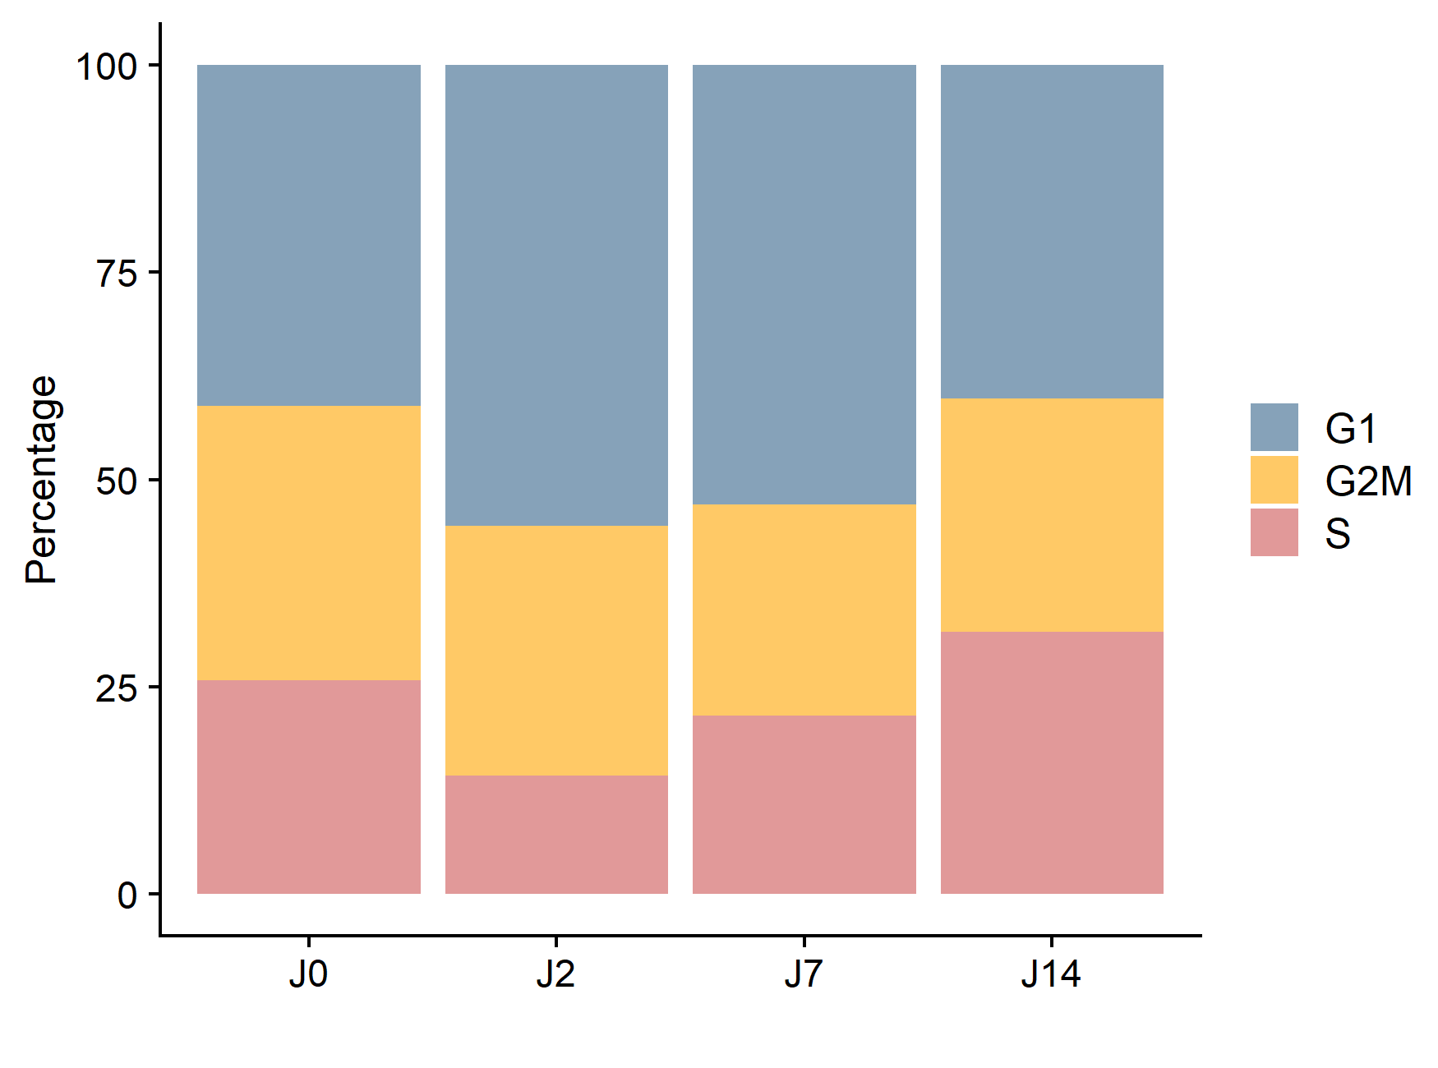
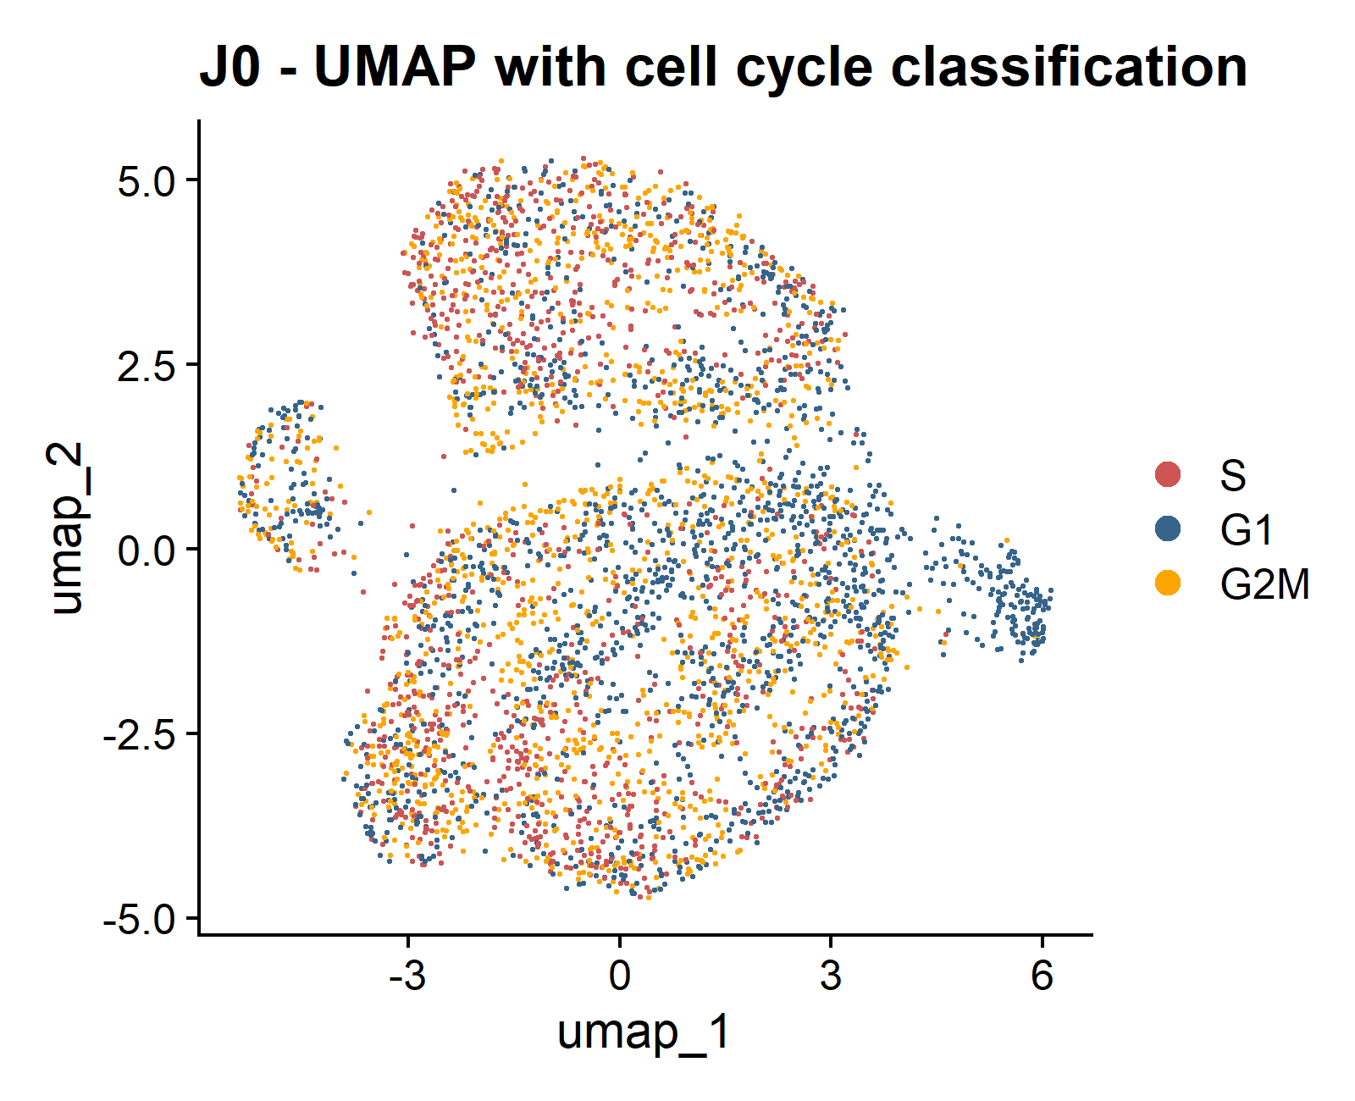
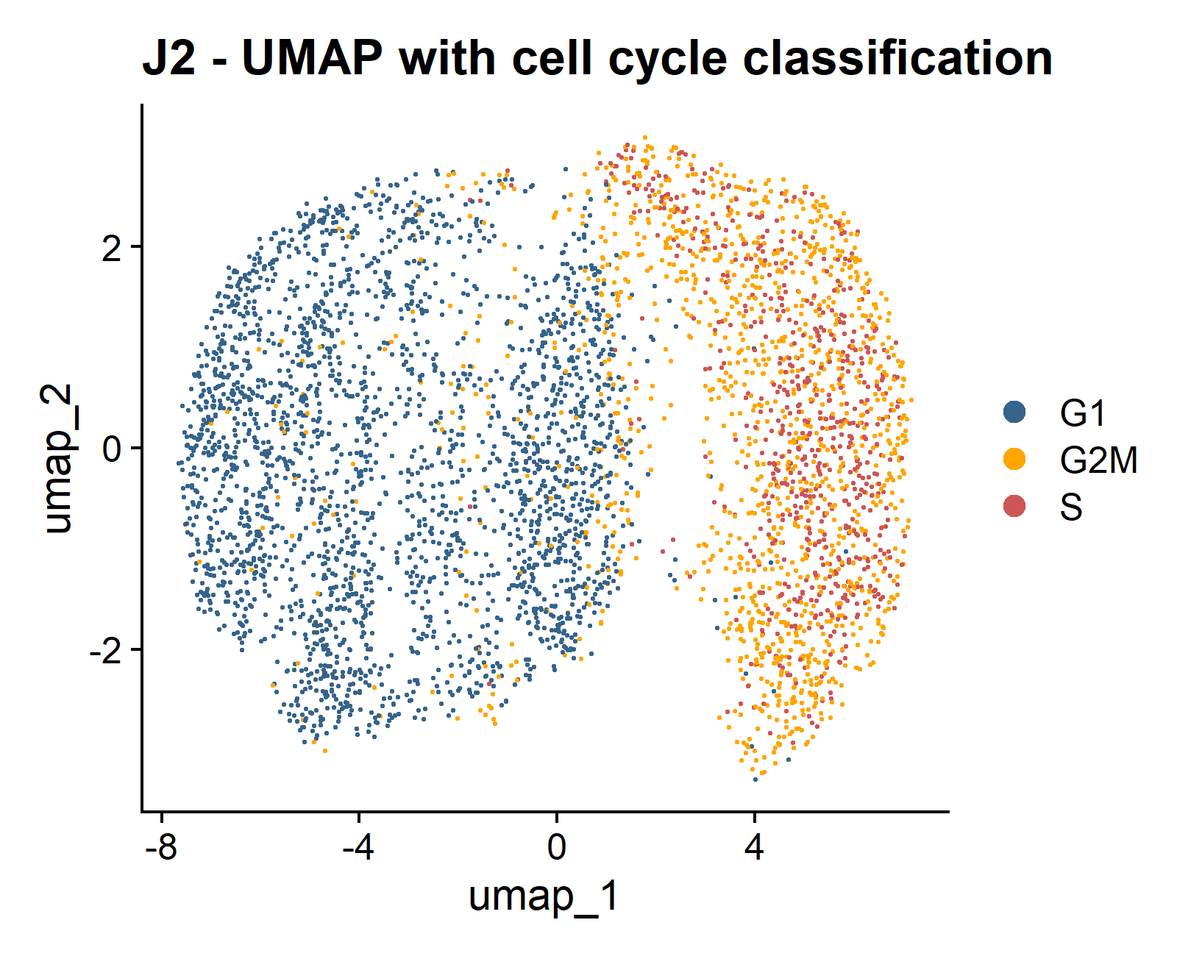
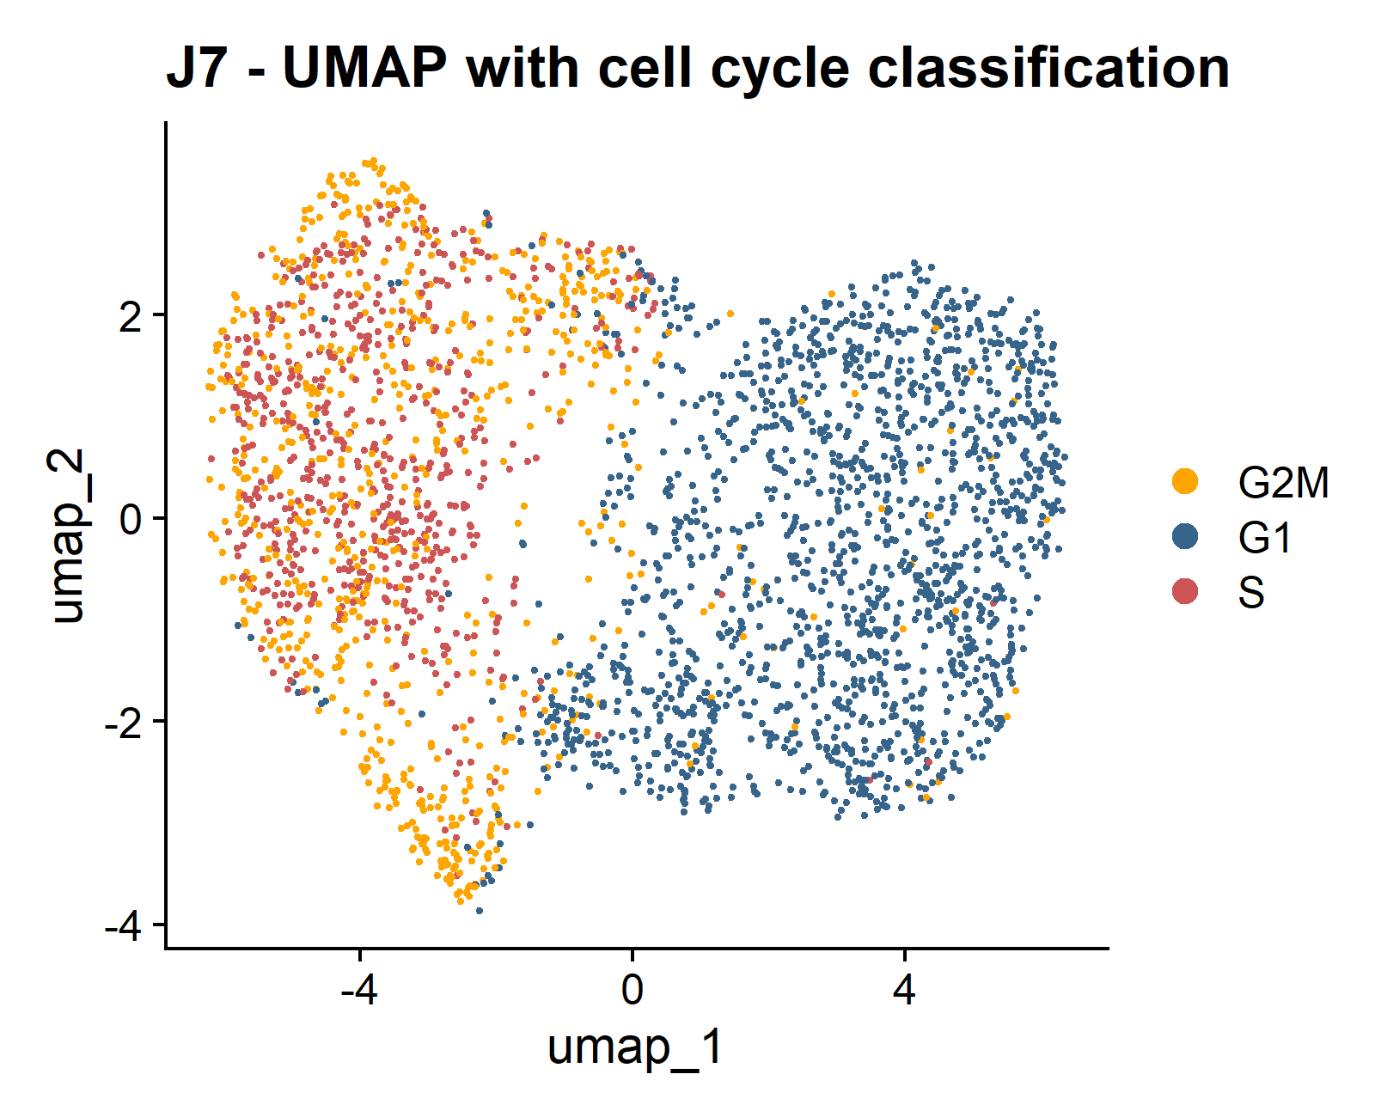
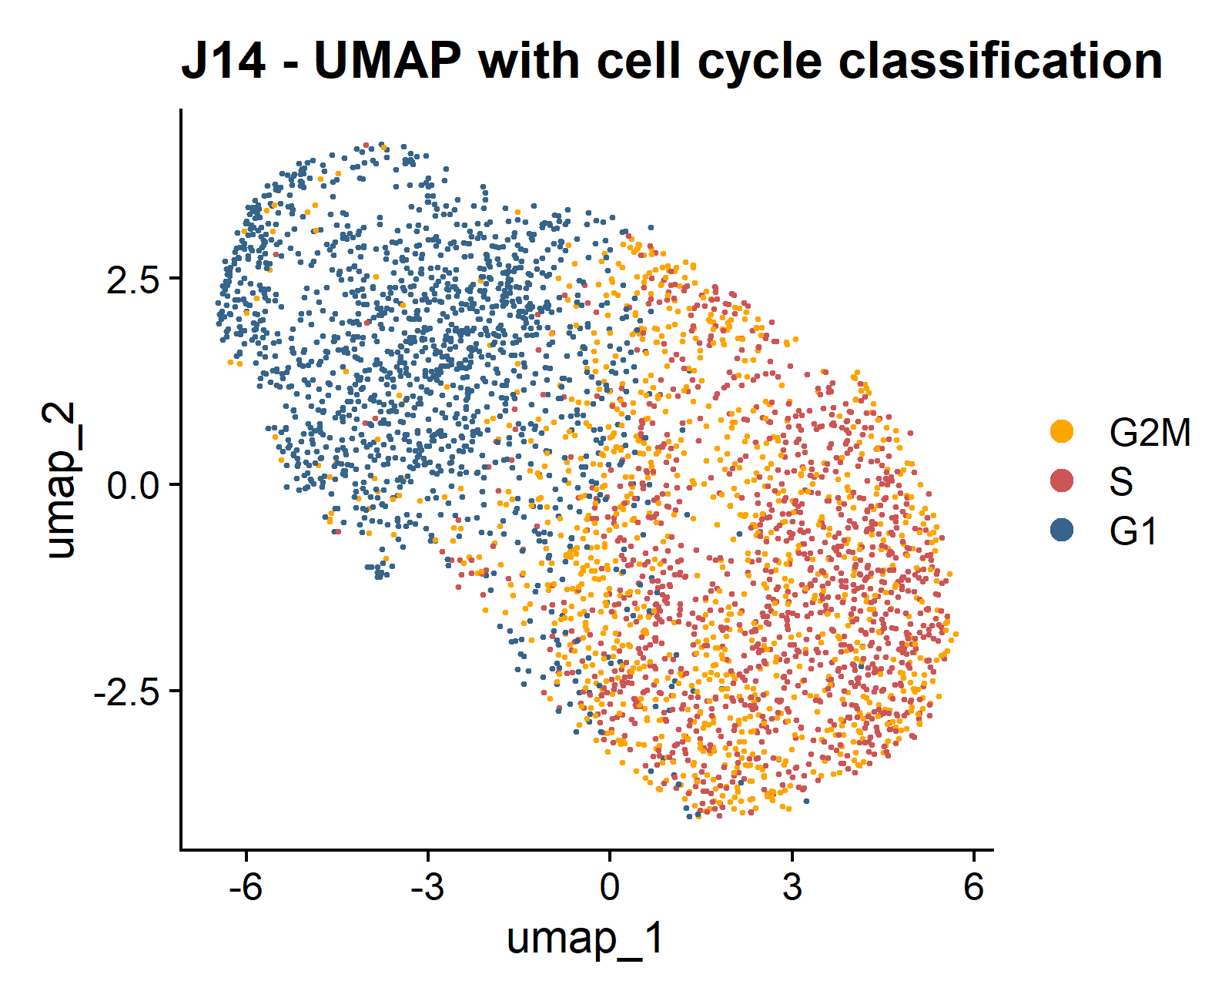
Universitat Oberta
de Catalunya
uoc.edu
RESULTS
A)
B)
By Time points
Cell Cycle Identification
C)
D)

Slide 11
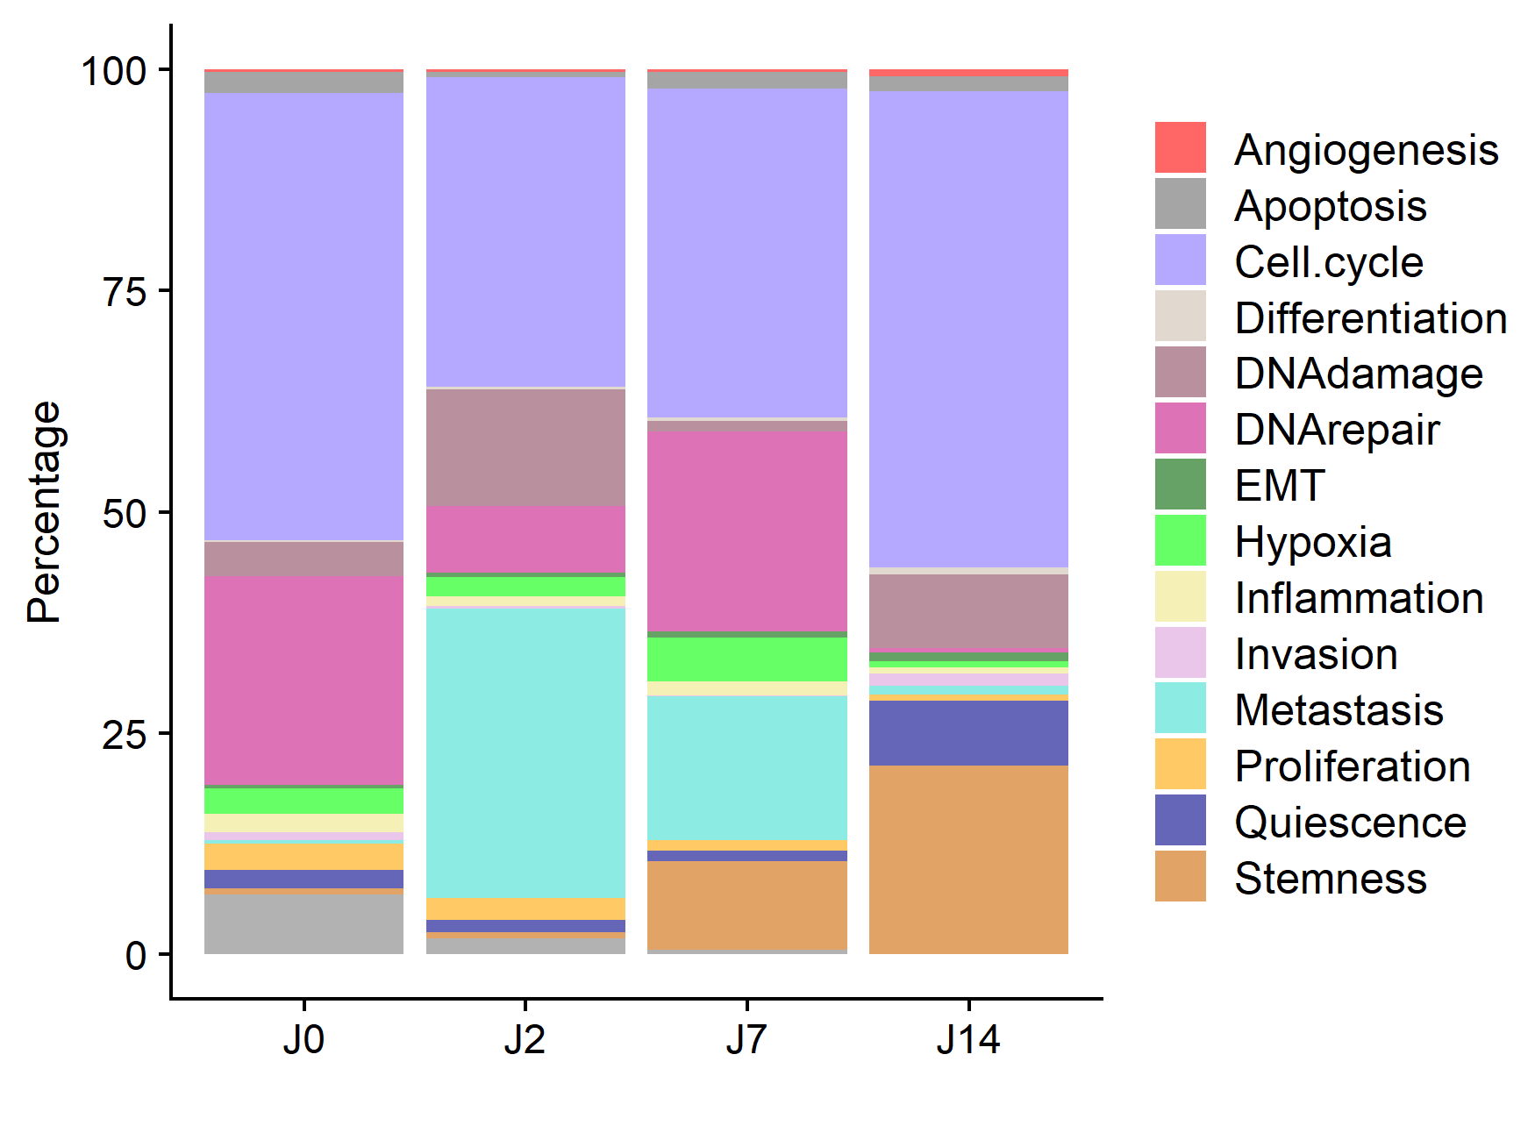
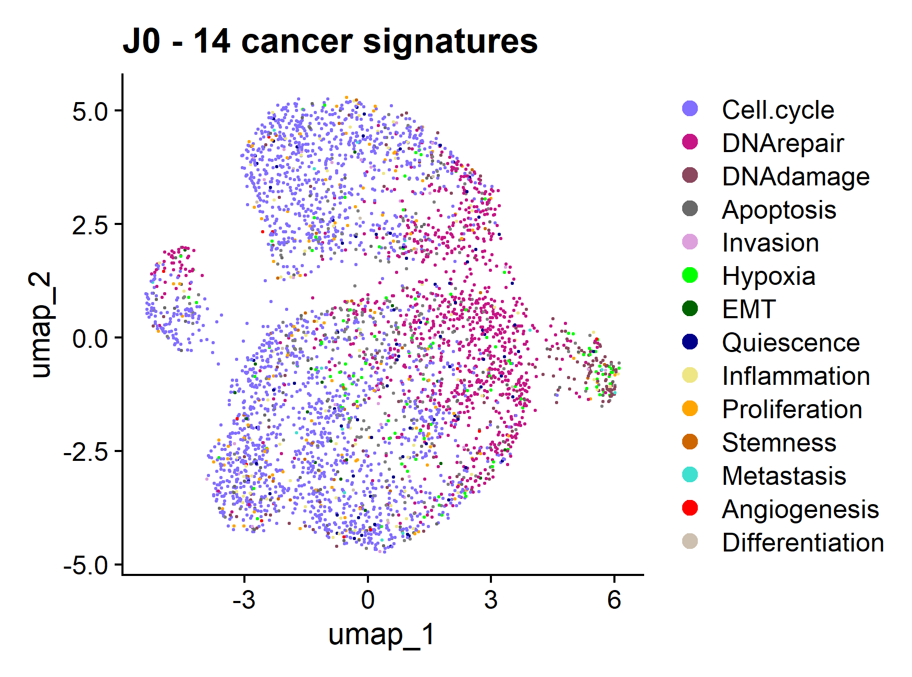
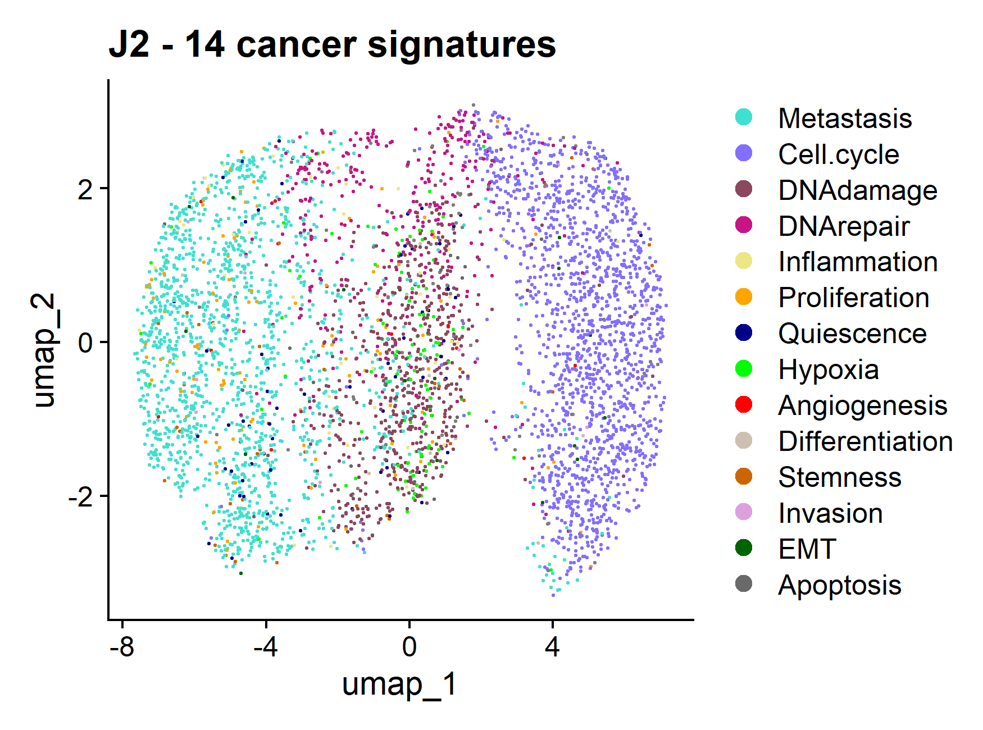
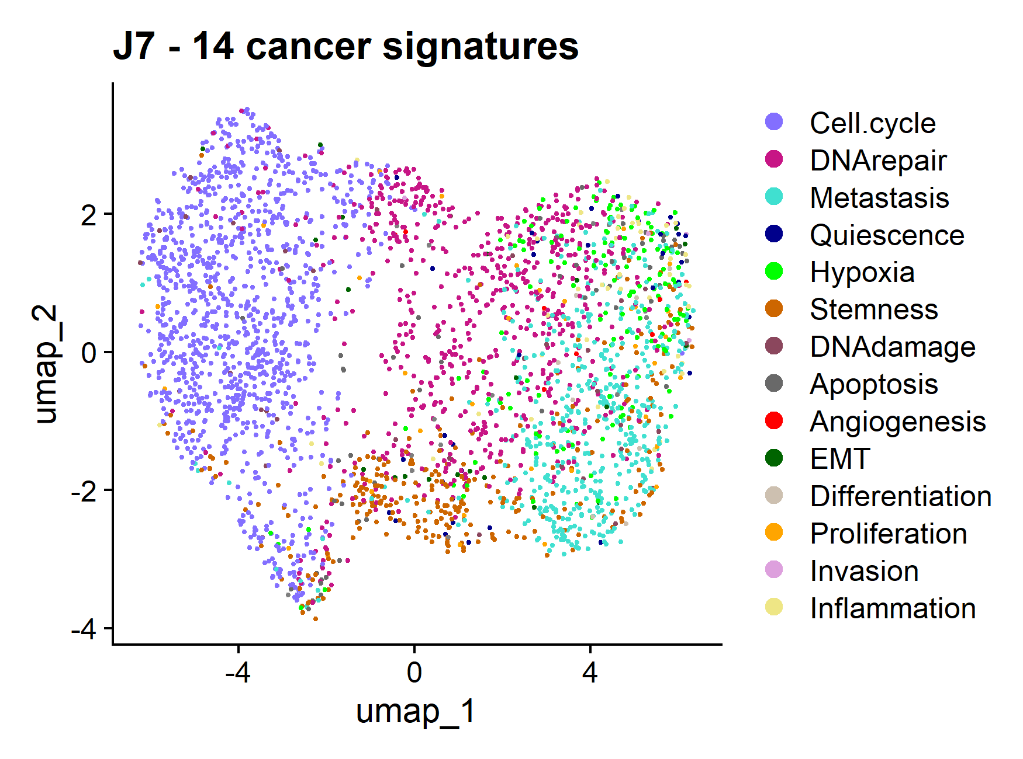
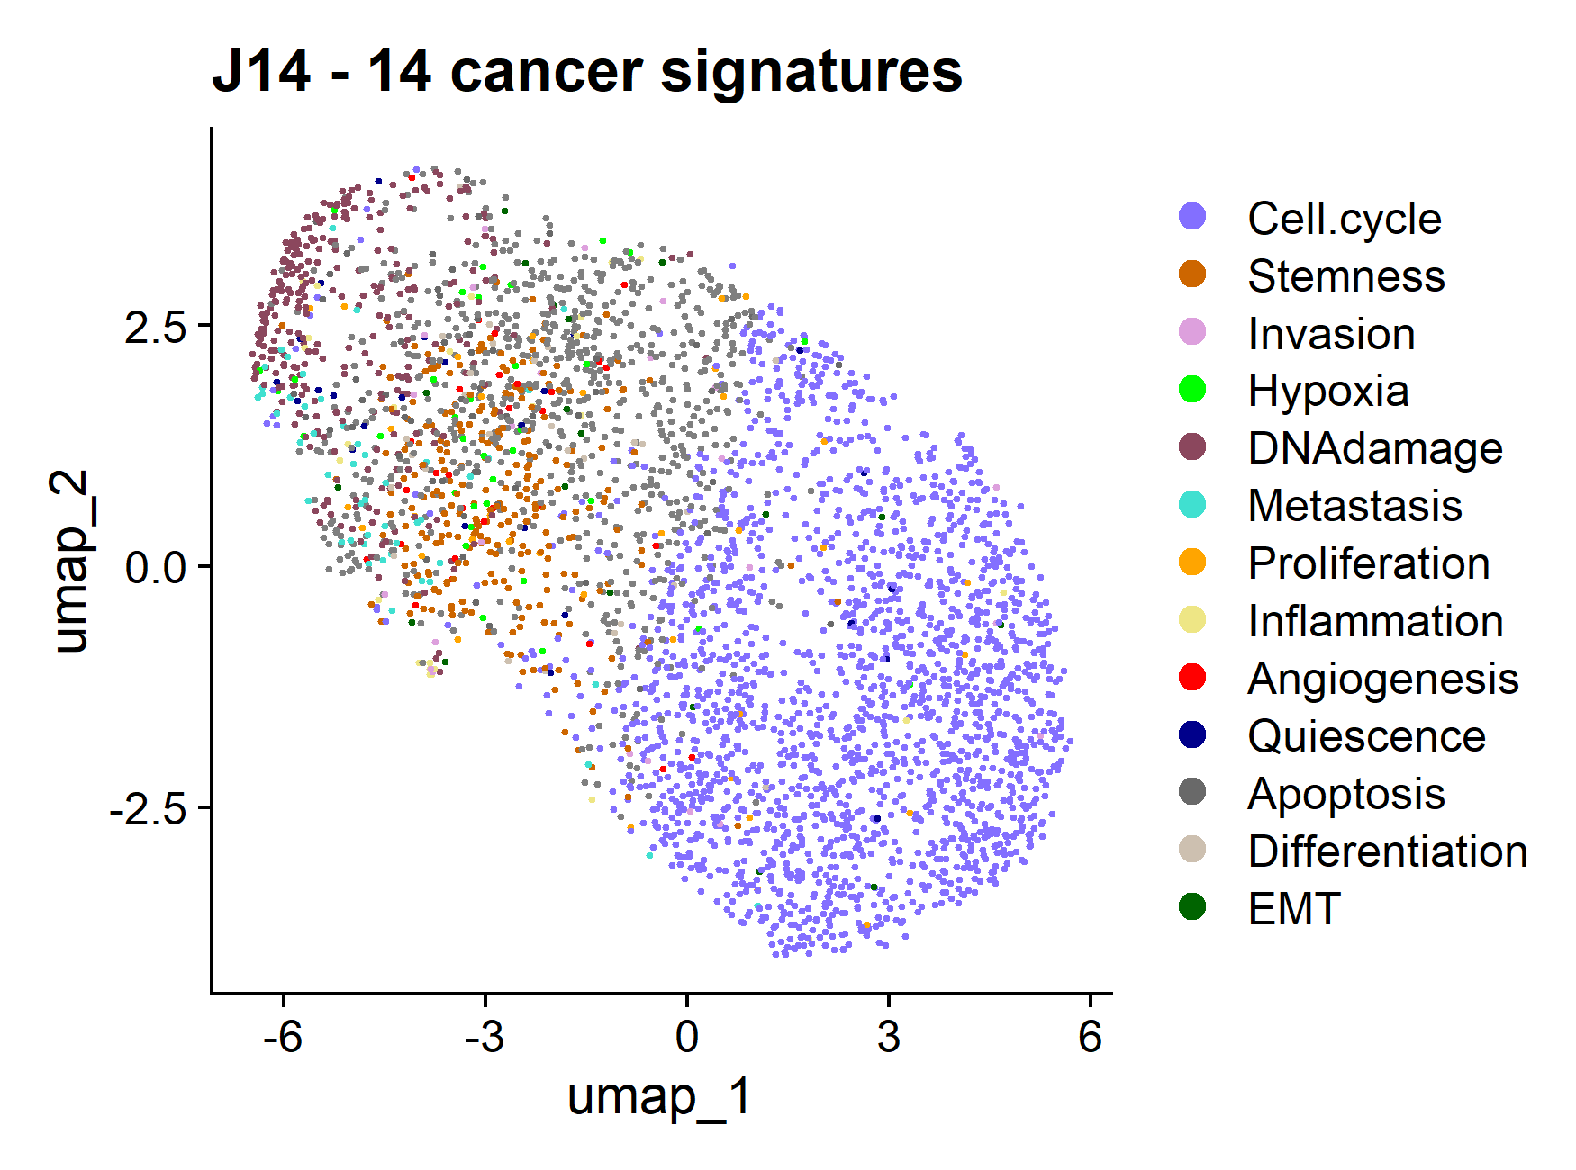
Universitat Oberta
de Catalunya
uoc.edu
A)
B)
RESULTS
By Time points
CancerSEA
C)
D)

Slide 12
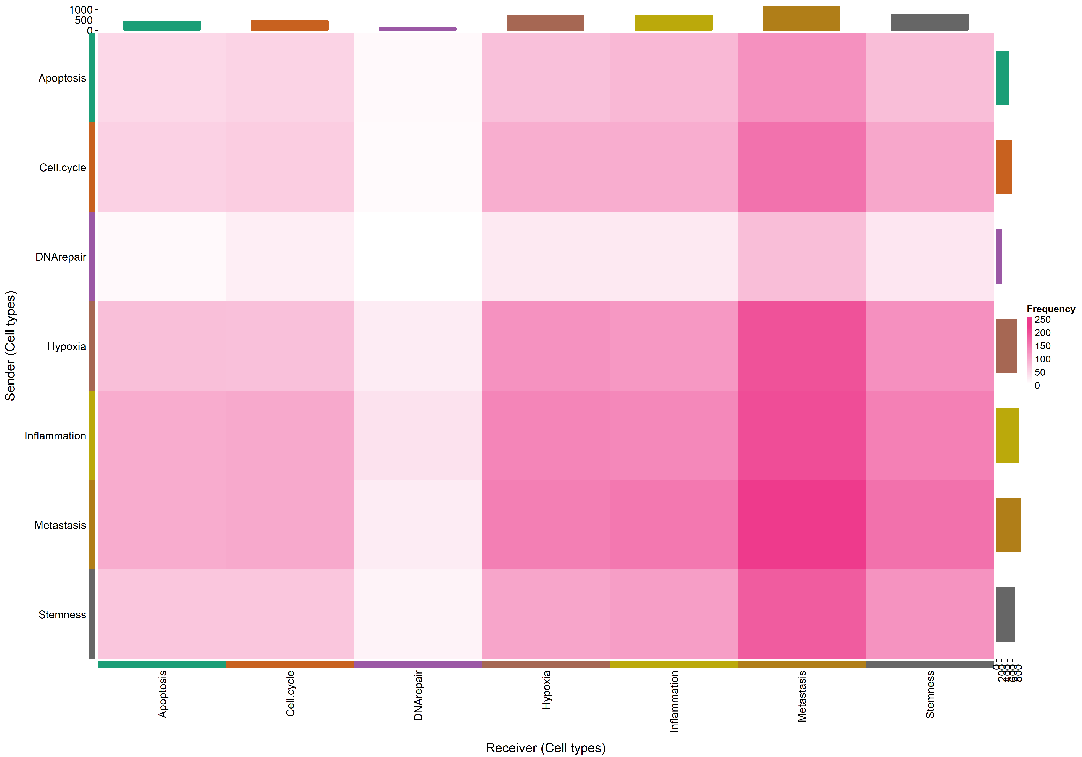
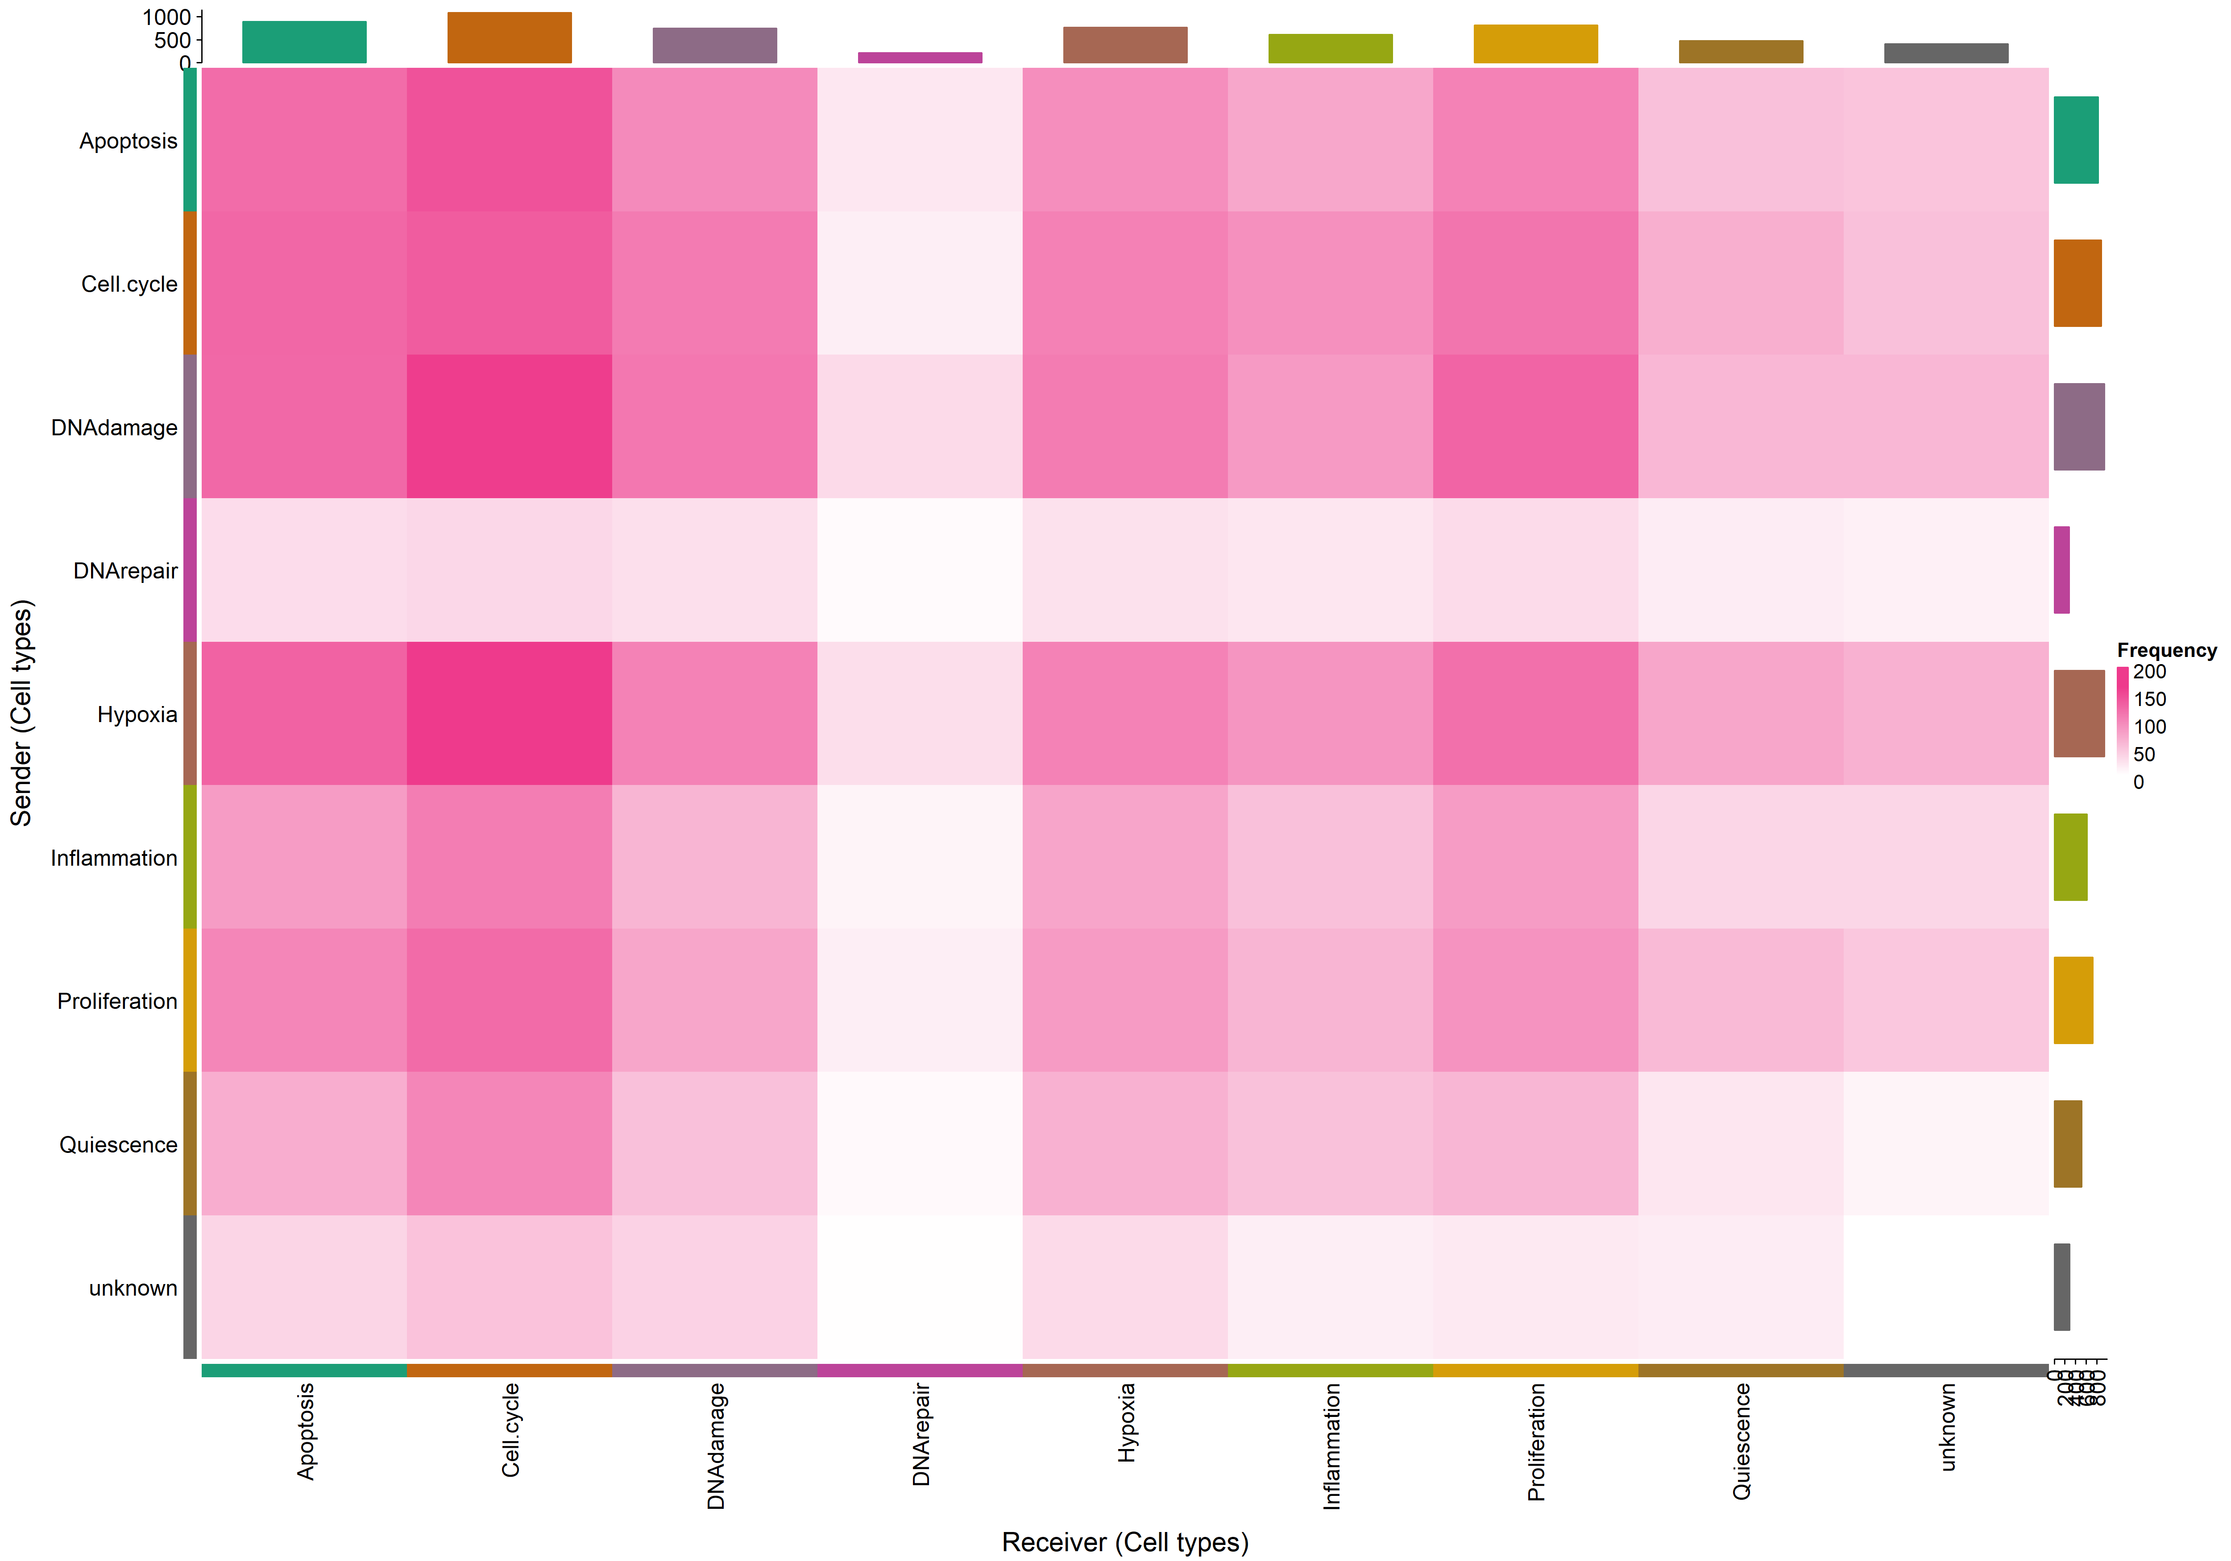
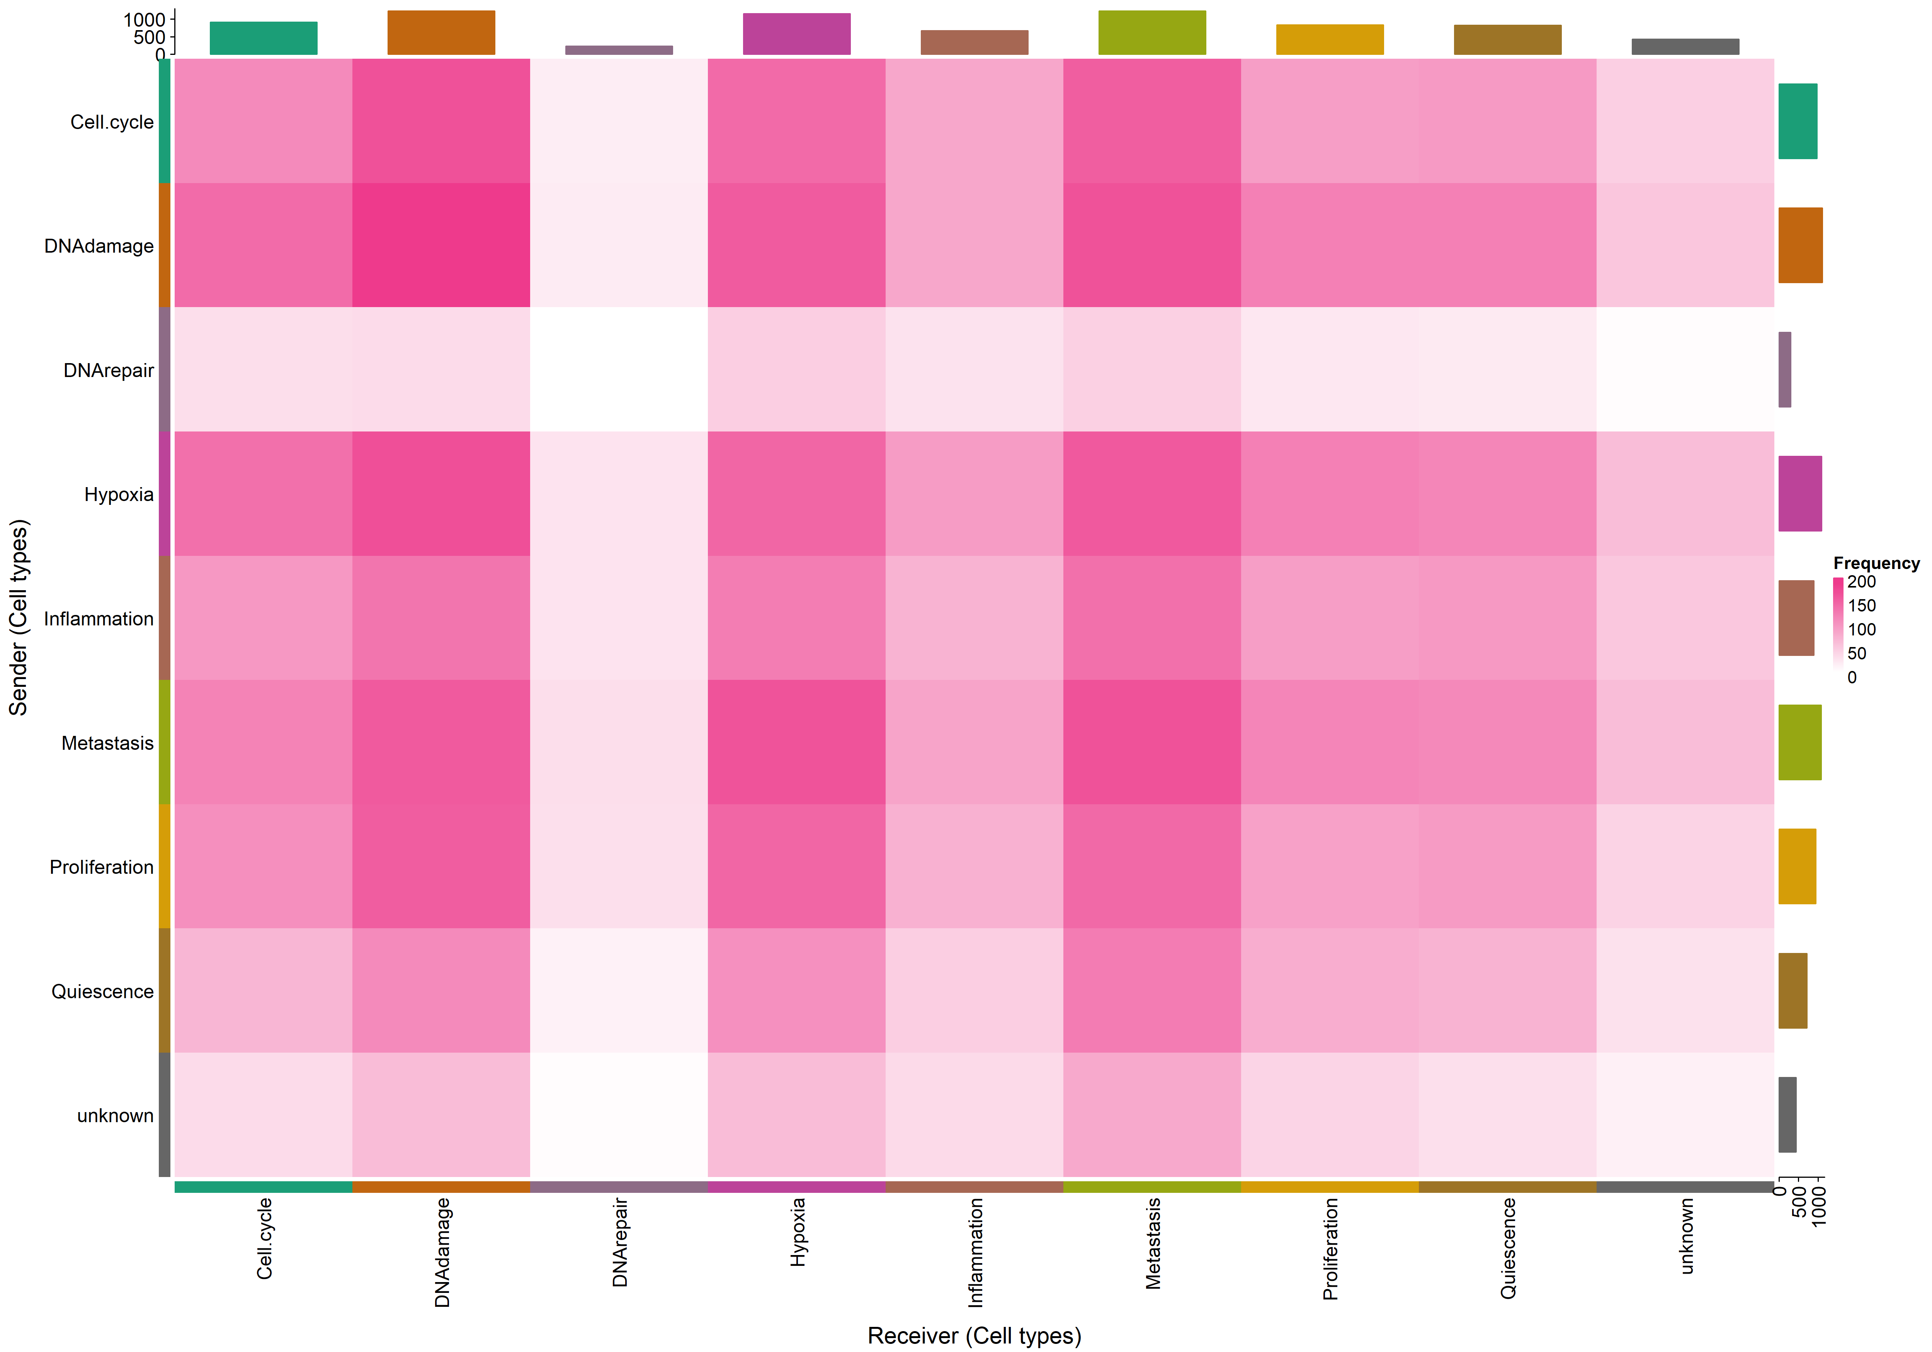
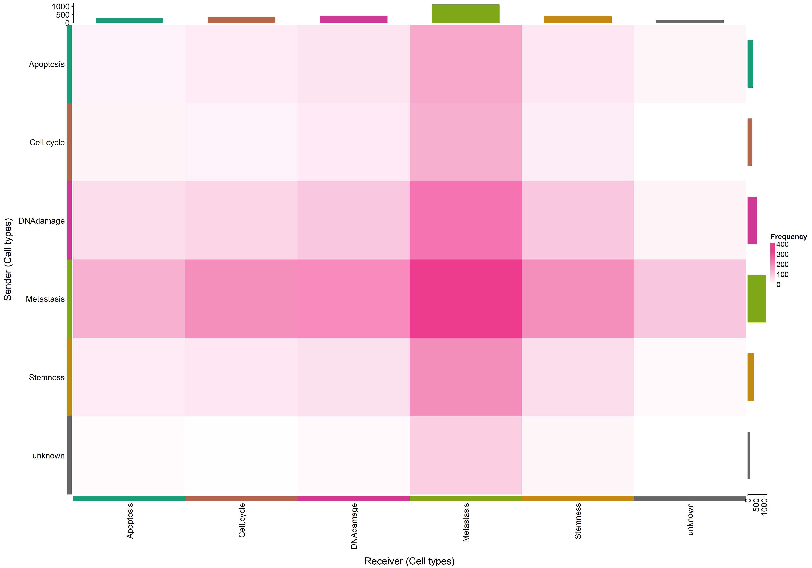
Universitat Oberta
de Catalunya
uoc.edu
RESULTS
By Time points
CancerSEA
CCC Results
Day 14
Day 2
Day 0
Day 7

Slide 13
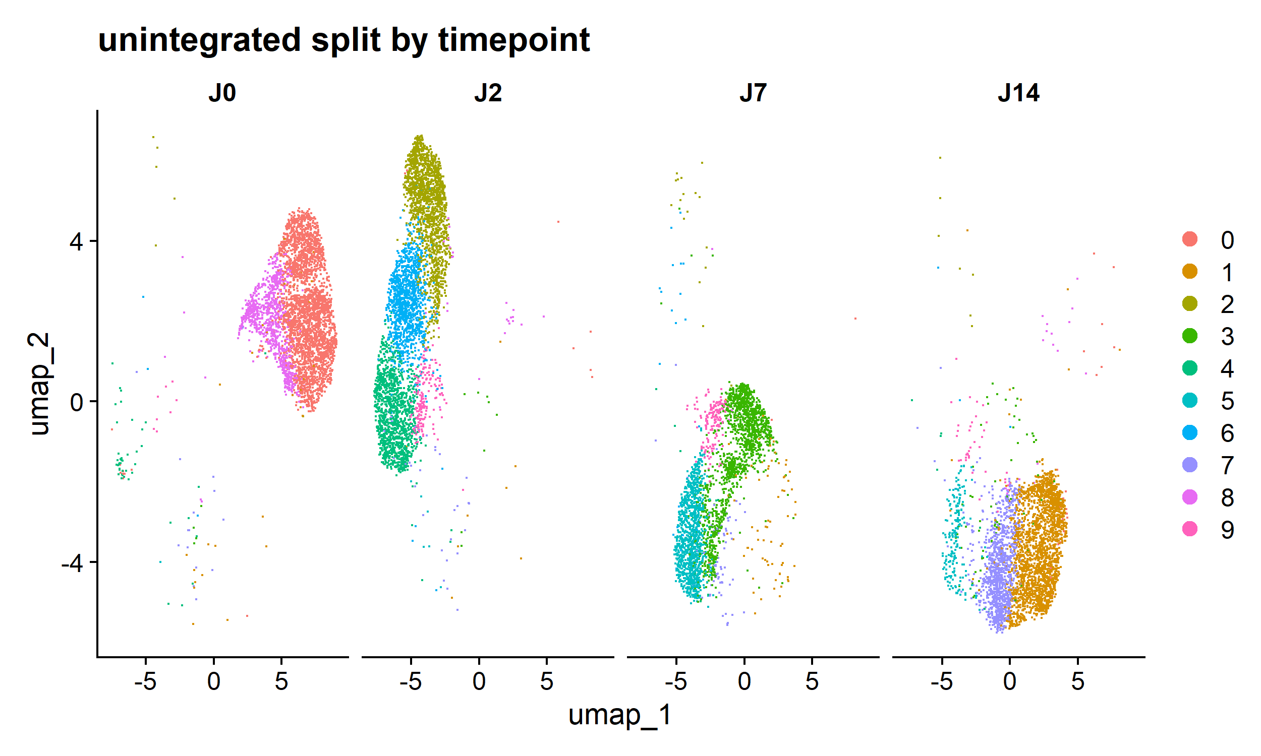
Universitat Oberta
de Catalunya
uoc.edu
RESULTS
Integrative analysis
Unintegrative method
Seurat Clusters

Slide 14
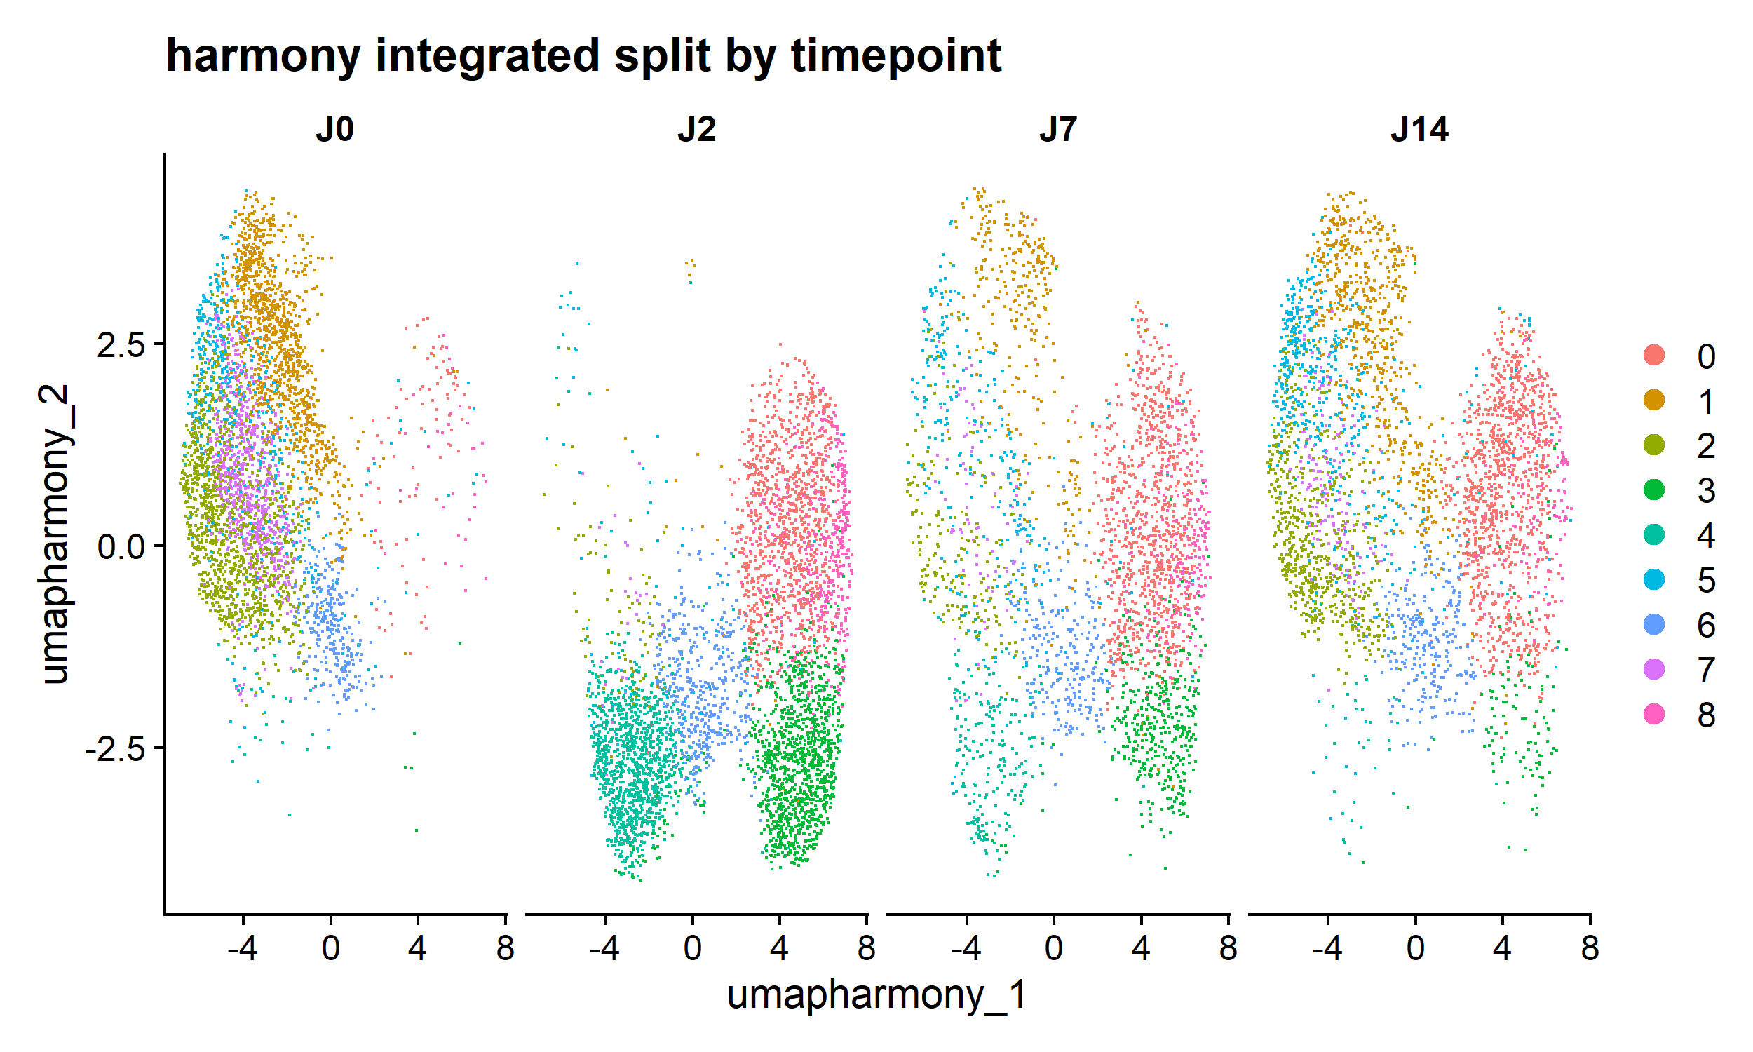
Universitat Oberta
de Catalunya
uoc.edu
RESULTS
Integrative analysis
Harmony method
Seurat Clusters

Slide 15
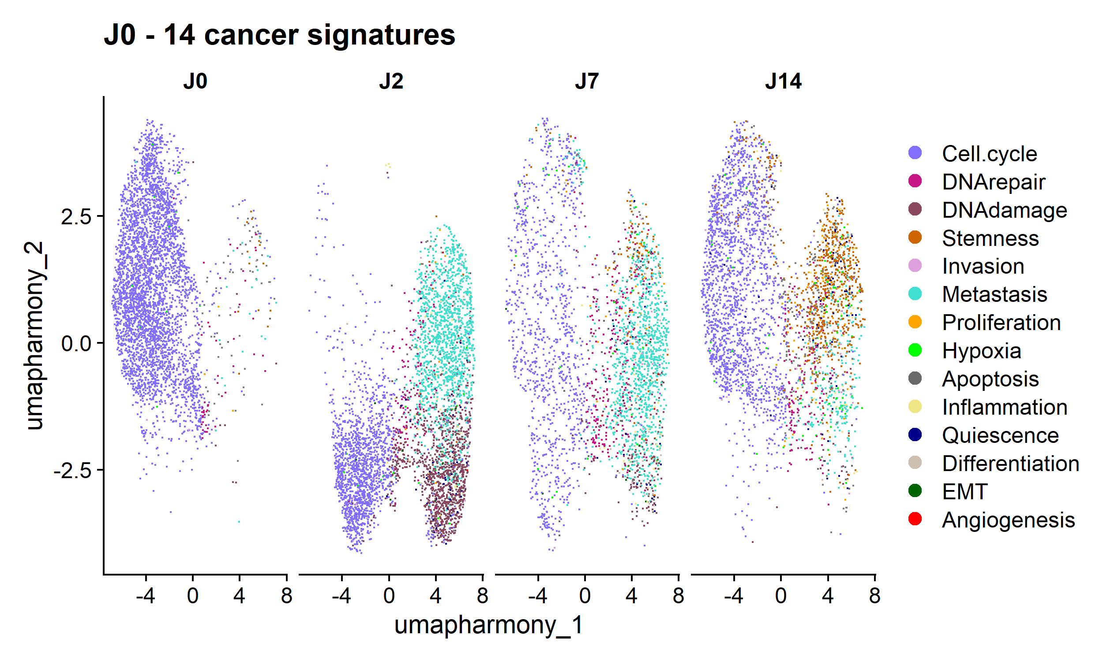
Universitat Oberta
de Catalunya
uoc.edu
RESULTS
Integrative analysis
Unintegrative method
CancerSEA Clusters

Slide 16
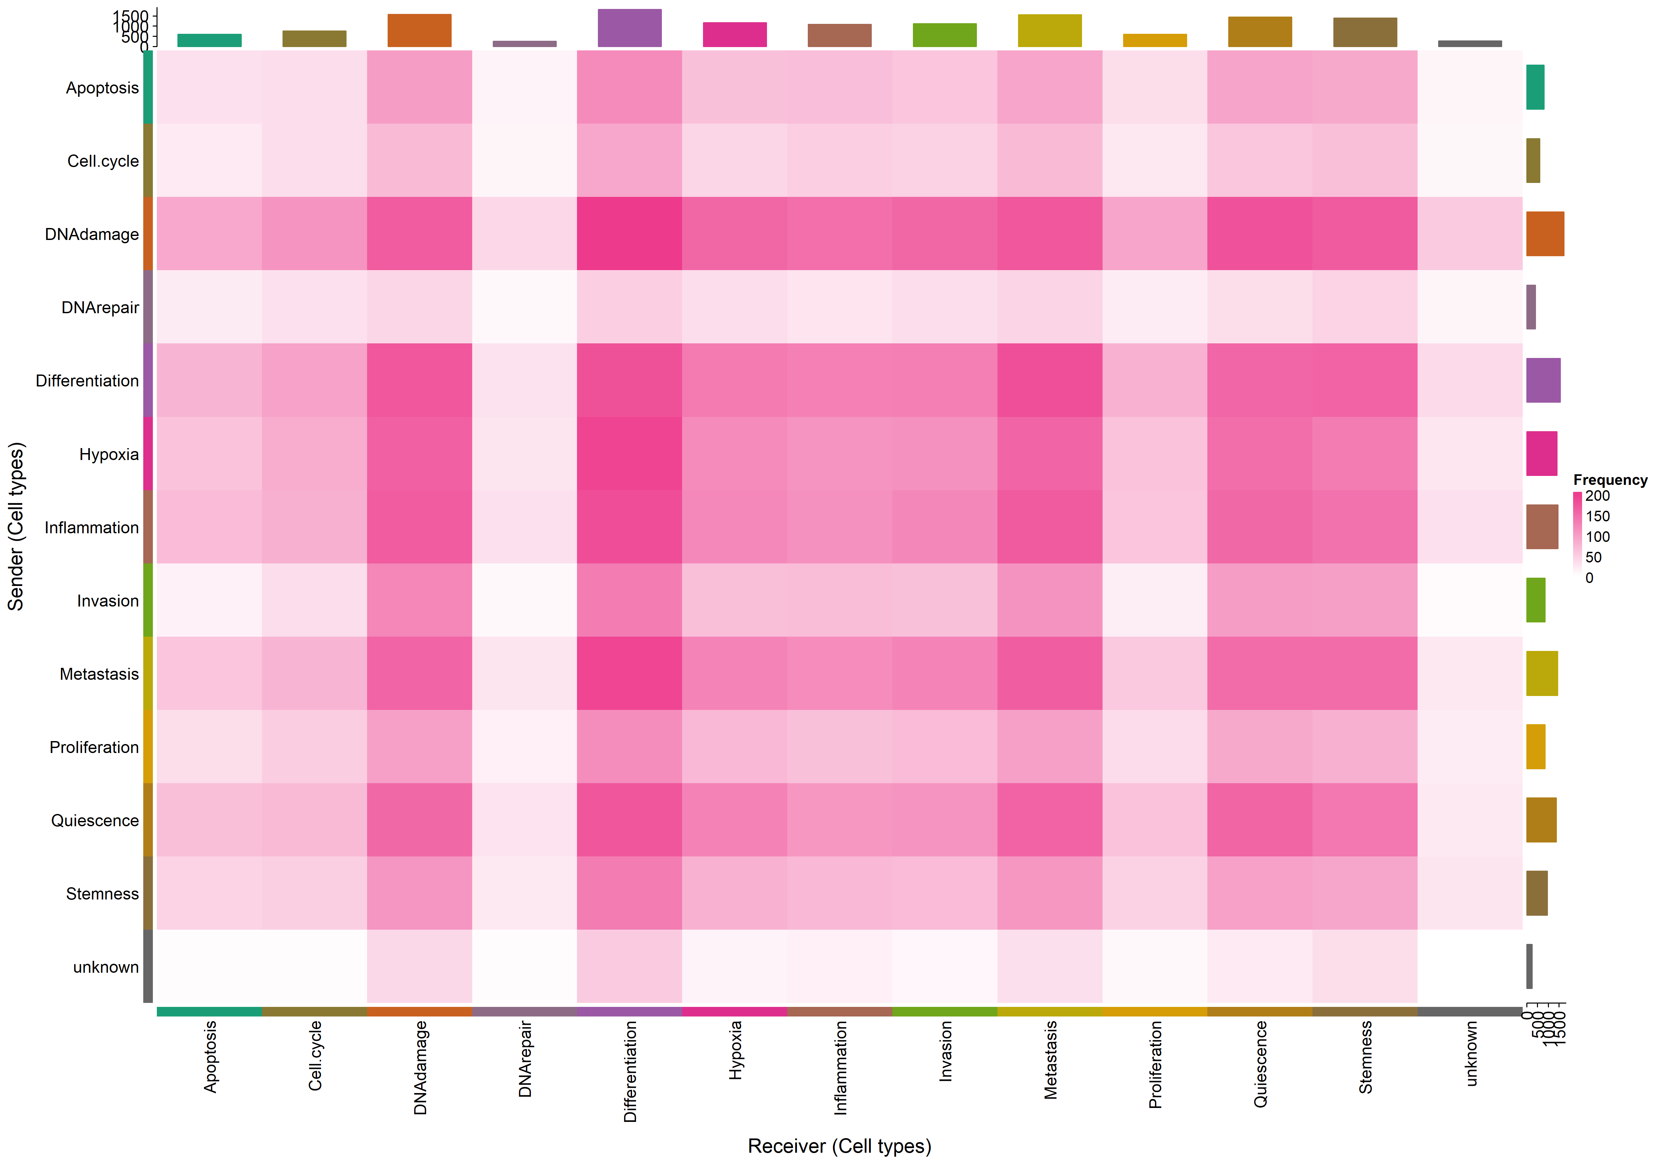
Universitat Oberta
de Catalunya
uoc.edu
RESULTS
Integrative analysis
CancerSEA
CCC results

Slide 17
Universitat Oberta
de Catalunya
uoc.edu
CONCLUSIONS
Primary aim: Investigate and characterize cancer cell subpopulations responding to 5-FU.
Key Findings:
Characterization of Seurat Subpopulations
6 clusters identified by Seurat.
Post-treatment increases cell population on clusters 0 and 5.
By day 14, absence of cluster 6 an increase in cluster 3.
Key Findings:
Cell Cycle Dynamics:
Increase in G1 phase cells post-treatment (day 2)
Resurgence in S/G2M phases by day 14
Initial G1 phase arrest, possible evading mechanism against 5-FU
Key Findings:
Adaptation Mechanisms:
Increased DNA repair by 7th day
Higher stemness cell population by day 7 and 14
Selection of high metastatic cells from the CCC Analysis.
Key Findings:
CCC Networks:
Significant interactions noted in DNA damage, hypoxia, and proliferation pathways.
Reduced DNA repair interactions; increased interactions in DNA damage and stemness
Biological Implications
High Plasticity and Heterogeneity
Therapeutic Targeting:
Stemness and metastatic pathways could be key to overcoming resistance and preventing relapse
New therapies that target DNA repair pathways or stem cell signaling
Future Research Directions:
Detailed study of LR
Functional studies are needed
Exploring new combination therapies with 5-FU

